Slide 1
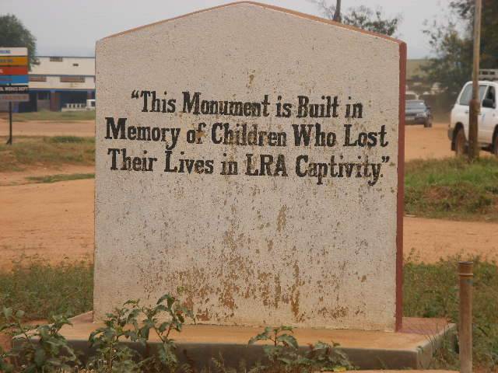
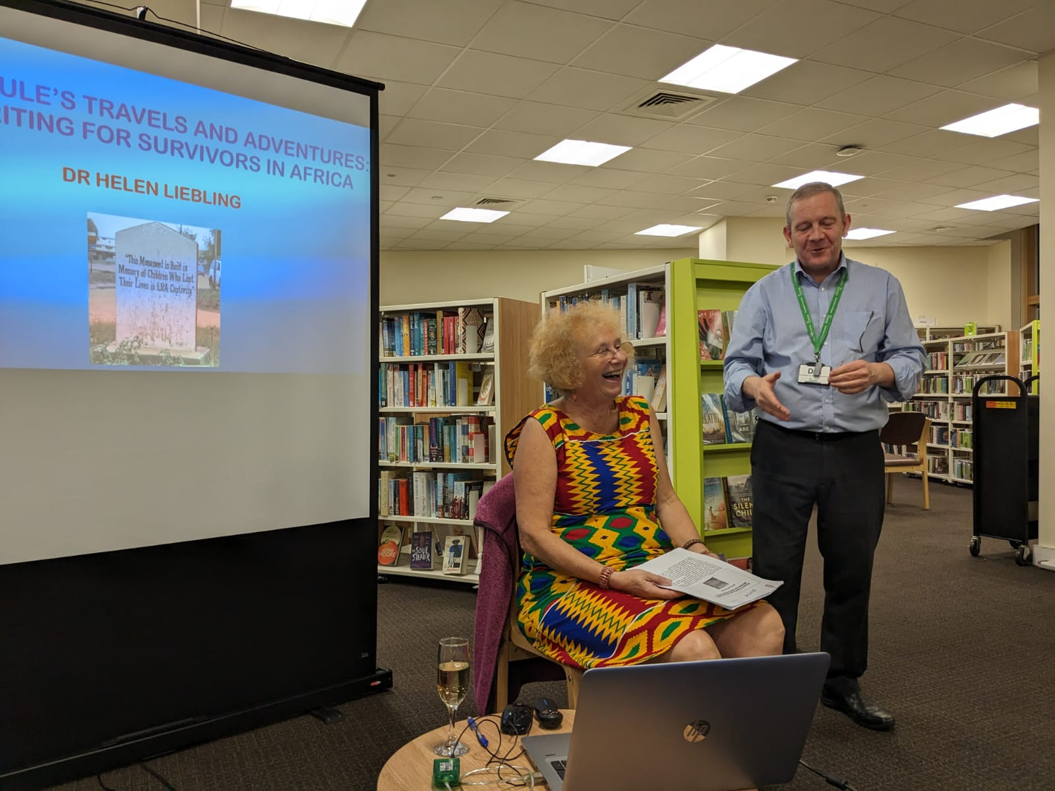
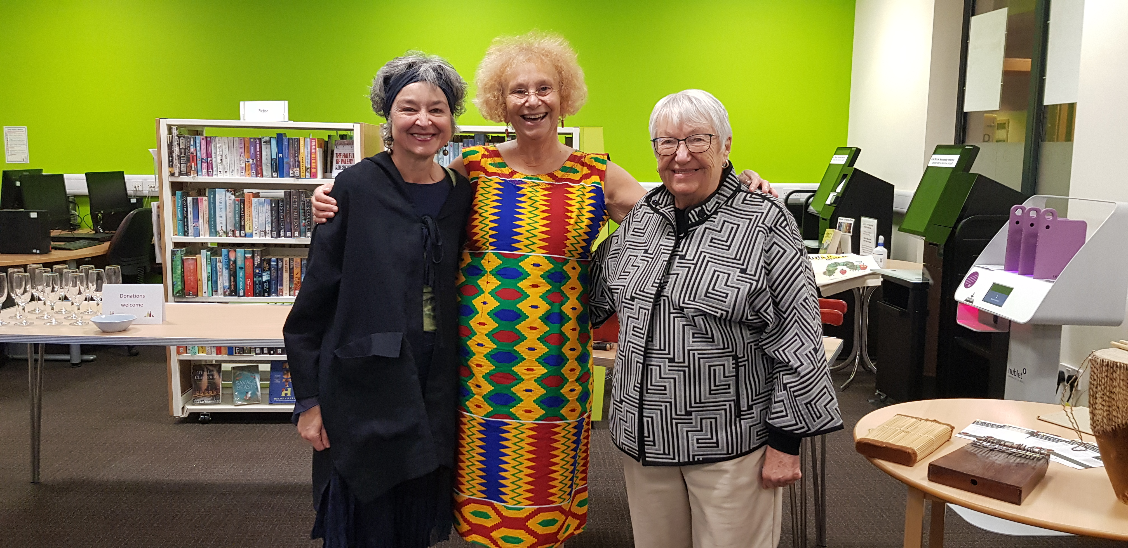
Nalule’s Travels and Adventures:
Writing for Survivors in Africa
Dr Helen Liebling
Book Launch
Southam Library 17th February 2024
Notes:
Many thanks to all at Southam for inviting me: Title and explain Nalule
Dr Helen Liebling, former clinical lead of refugee services in Coventry NHS-retired April 2022: currently work as Assistant Professor in Research and Clinical Psychology in Research Centre for Trust, Peace and Social Relations, Coventry University and a founding member of African Psycare Research Organisation (APRO) based in Uganda who carry out research and provide services for survivors of SGBV and torture.
Warning about sensitive content: important to highlight voices of survivors and service providers working with to validate their experiences.
Photo of monument taken in Northern Uganda where we (Bruce) carried out research with girl and boy children who fled abduction by the Lord’s Resistance Army, a rebel group. The children were forced to commit atrocities against their own communities and others and also survived appalling human rights abuses. Pleased to say that our research recommendations from this project were taken to the President of Uganda who implemented some of these with the Ministry of Health and his Security Council and set up services for the child survivors using our recommended approach.

Slide 2
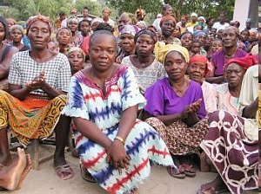
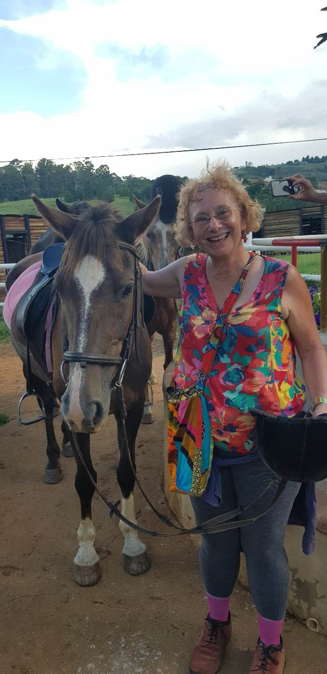
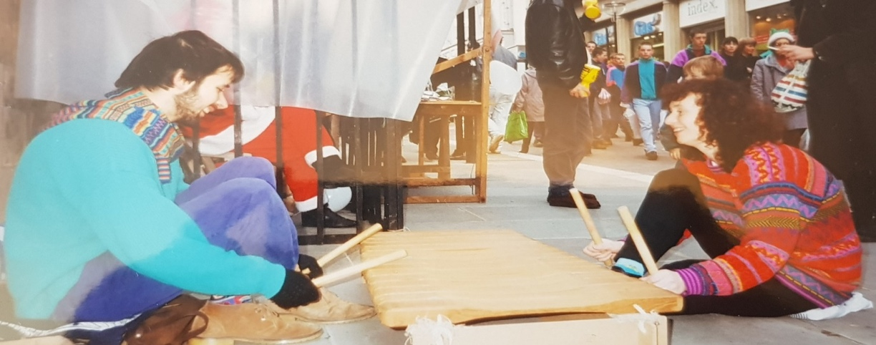
CONTENT
EARLY LIFE
WORK WITH CONFLICT SURVIVORS
A CHICKEN ON A BUS
Liberian Women Conflict Survivors
Playing Amadinda (Ugandan xylophone) in Liverpool with Andy for Amnesty International
Horse riding in Drakensburg
Mountains, South Africa
Notes:
Time for questions then informal discussion with refreshments afterwards

Slide 3
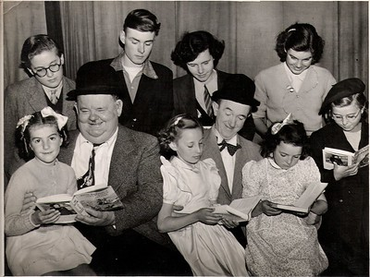
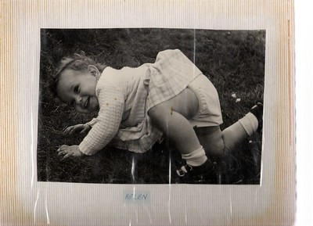
Early Life
BOUNCING INTO THE WORLD
FAMILY DISRUPTION
Mum (3rd from left back row) being awarded
a prize for painting by Laurel and Hardy
Me as a baby
Notes:
Read from book:
“I came bouncing into this world in the early hours of Wednesday, 22 November 1961, in a hospital on Loveday Street in Birmingham, following my mum’s rock-and-roll dancing the evening before. This must explain my love of music and dancing, I thought to myself when my mother related this story to me”
Father Jewish and Mum Christian. Father’s parents wore black and wouldn’t speak to us for 2 years when married: divorced when 13: responsible for caring for brother, sister and mother
Family separation and Jewish ancestry led to passion for advocating for rights of those who survived human rights violations
Both parents remarried but relied more on friends for support throughout my life (discuss picture of Mum):

Slide 4

Work with Conflict Survivors
TRAVEL TO UGANDA TO RECORD TRADITIONAL MUSIC
CLINICAL PSYCHOLOGY COURSE
PhD: ‘A GENDERED ANALYSIS OF THE EXPERIENCES OF UGANDAN WOMEN WAR SURVIVORS’
Practising embaire at Westminster Abbey Performance for Queen’s Jubilee
Notes:
First travelled to Uganda in 1992 with Andy my former partner and his late father Peter Cooke, a professor of ethnomusicology from Edinburgh University. Andy was teaching me traditional Ugandan music. We went to record traditional music in Busoga, East-happy to play a thumb piano song at the end if any wishes me to? Discuss photo
As requested by Makerere University, I helped set up first Clinical psychology course in East Africa through British Council link; I worked as Senior Lecturer there in 1987-1988
Whilst working in Uganda invited by Women’s International Peace Centre to assist with an intervention to provide medical and psychological treatment for women conflict survivors in Luwero District; WIPC document narratives of women and girls internationally and campaign with governments to improve support for survivors and have over 200 organisations in rural areas across the world work closely with them
I returned to UK with my PhD ideas (Leeds then Warwick met Caroline) PhD title-see my research as action research-try to make a difference: Implemented recommendations: bore well (Dad rotary and Luwero engineers), medical intervention and goat breeding (Older feminist network funding S Wales)
Several research projects in collaboration with African partners to assist conflict survivors of SGBV and torture and try to improve service responses
Uganda: Former LRA abducted children;, evaluation trauma centres (services established using recs of research)
Liberia: Women conflict survivors,
Rwanda: Experiences of trauma services by perspectives of genocide survivors and staff
Eastern DRC: Women and girls who bore children from rape: health and justice services
United Kingdom: Refugee research and also working with women peacebuilders in East Africa
Happy to answer questions about this work in discussion

Slide 5
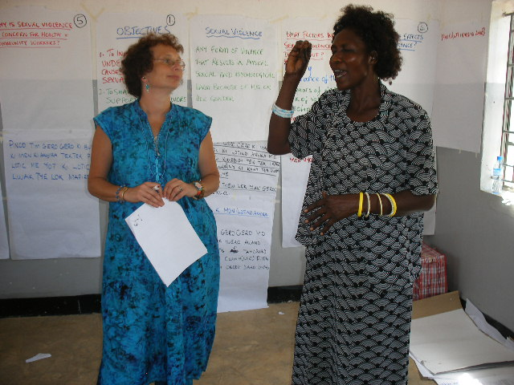
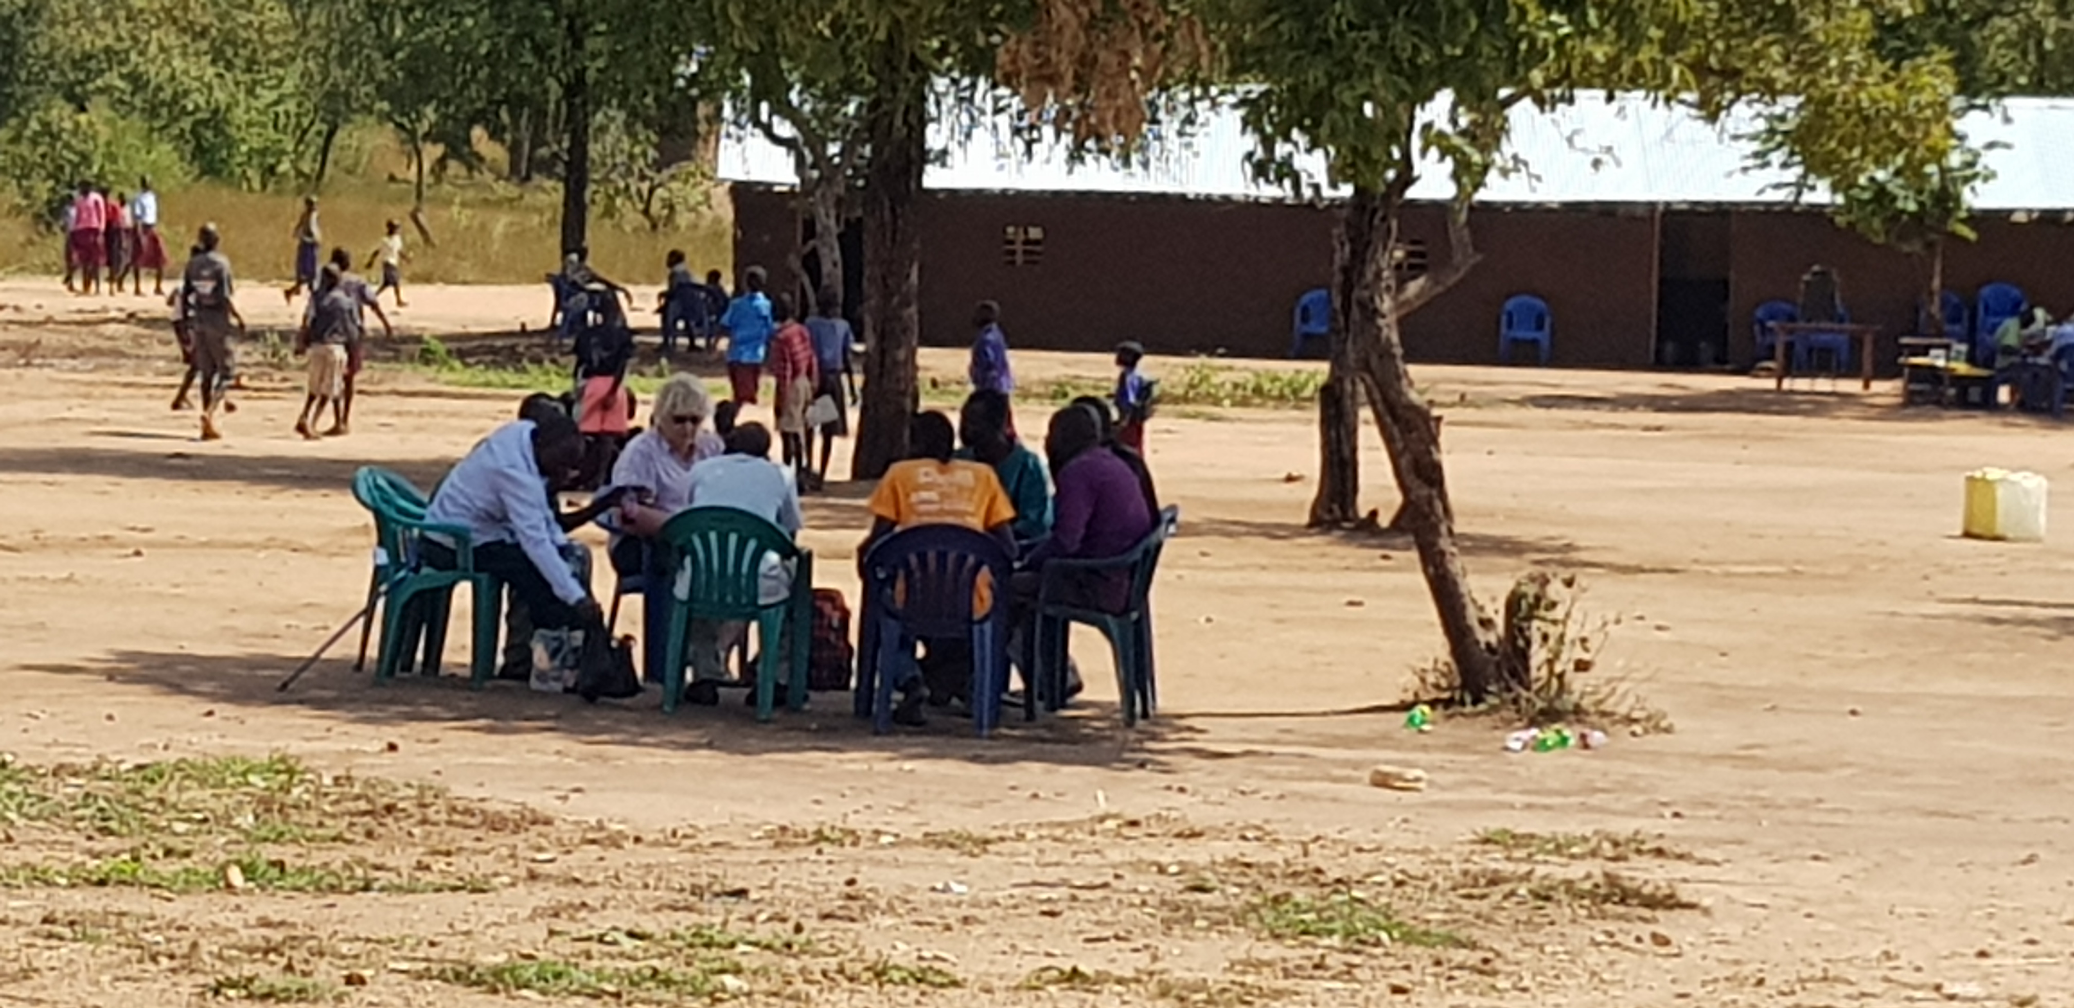
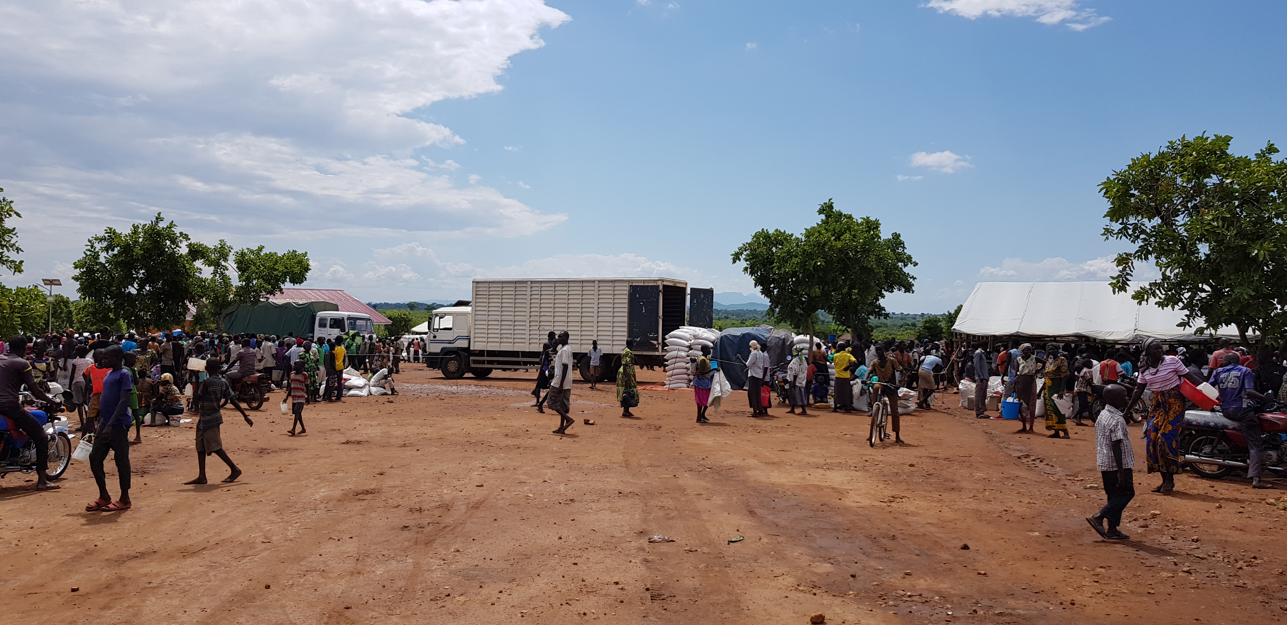
Social Enterprise Groups for South Sudanese Refugee Survivors of Sexual and Gender-Based Violence and Torture Living in Settlements in Northern Uganda
Helen Liebling, Hazel Barrett, Pascal Niyonguru and Gladys Canogura
Establish peer support social enterprises to improve lives of South Sudanese refugees living in settlements who experienced torture and/or Sexual and Gender-Based Violence
November 2018: 4 women’s and 2 men’s social enterprise groups in Pagirinya, Mungula and Bidi Bidi settlements
Training-business skills and emotional support
July 2019 evaluation
Notes:
1.Over 1.5 million registered refugees living in settlements (UNHCR, 2018) Uganda refugee policy gives South Sudanese refuge, enables them to work and gives houses and land (Ugandan Government, 2018)
2. Following previous BA research refugees said they wanted support establishing businesses & peer support groups to assist address issues they faced. Obtained funding through Coventry University to establish peer support social enterprises to try to improve lives of South Sudanese refugees:
Established groups in November 2018 including 4 women’s and 2 men’s groups in Pagirinya and Mungula in Adjumani and Bidi Bidi
Gave training in business skills and emotional support
Evaluation in July 2019 where ran focus groups, visited social enterprises and administered rating scale
Photos: Worked closely with Kitgum Women’s Peace Initiative and Refugee Welfare Councils (photo me and Gladys Director training on supporting SGBV survivors in Orom, N. Uganda). Hazel running focus group in Bidi Bidi. Food distribution 12 kg to registered women (per family) many NOT registered (NO RATIONS) and now three levels of rations Ugandan government trying to resolve

Slide 6
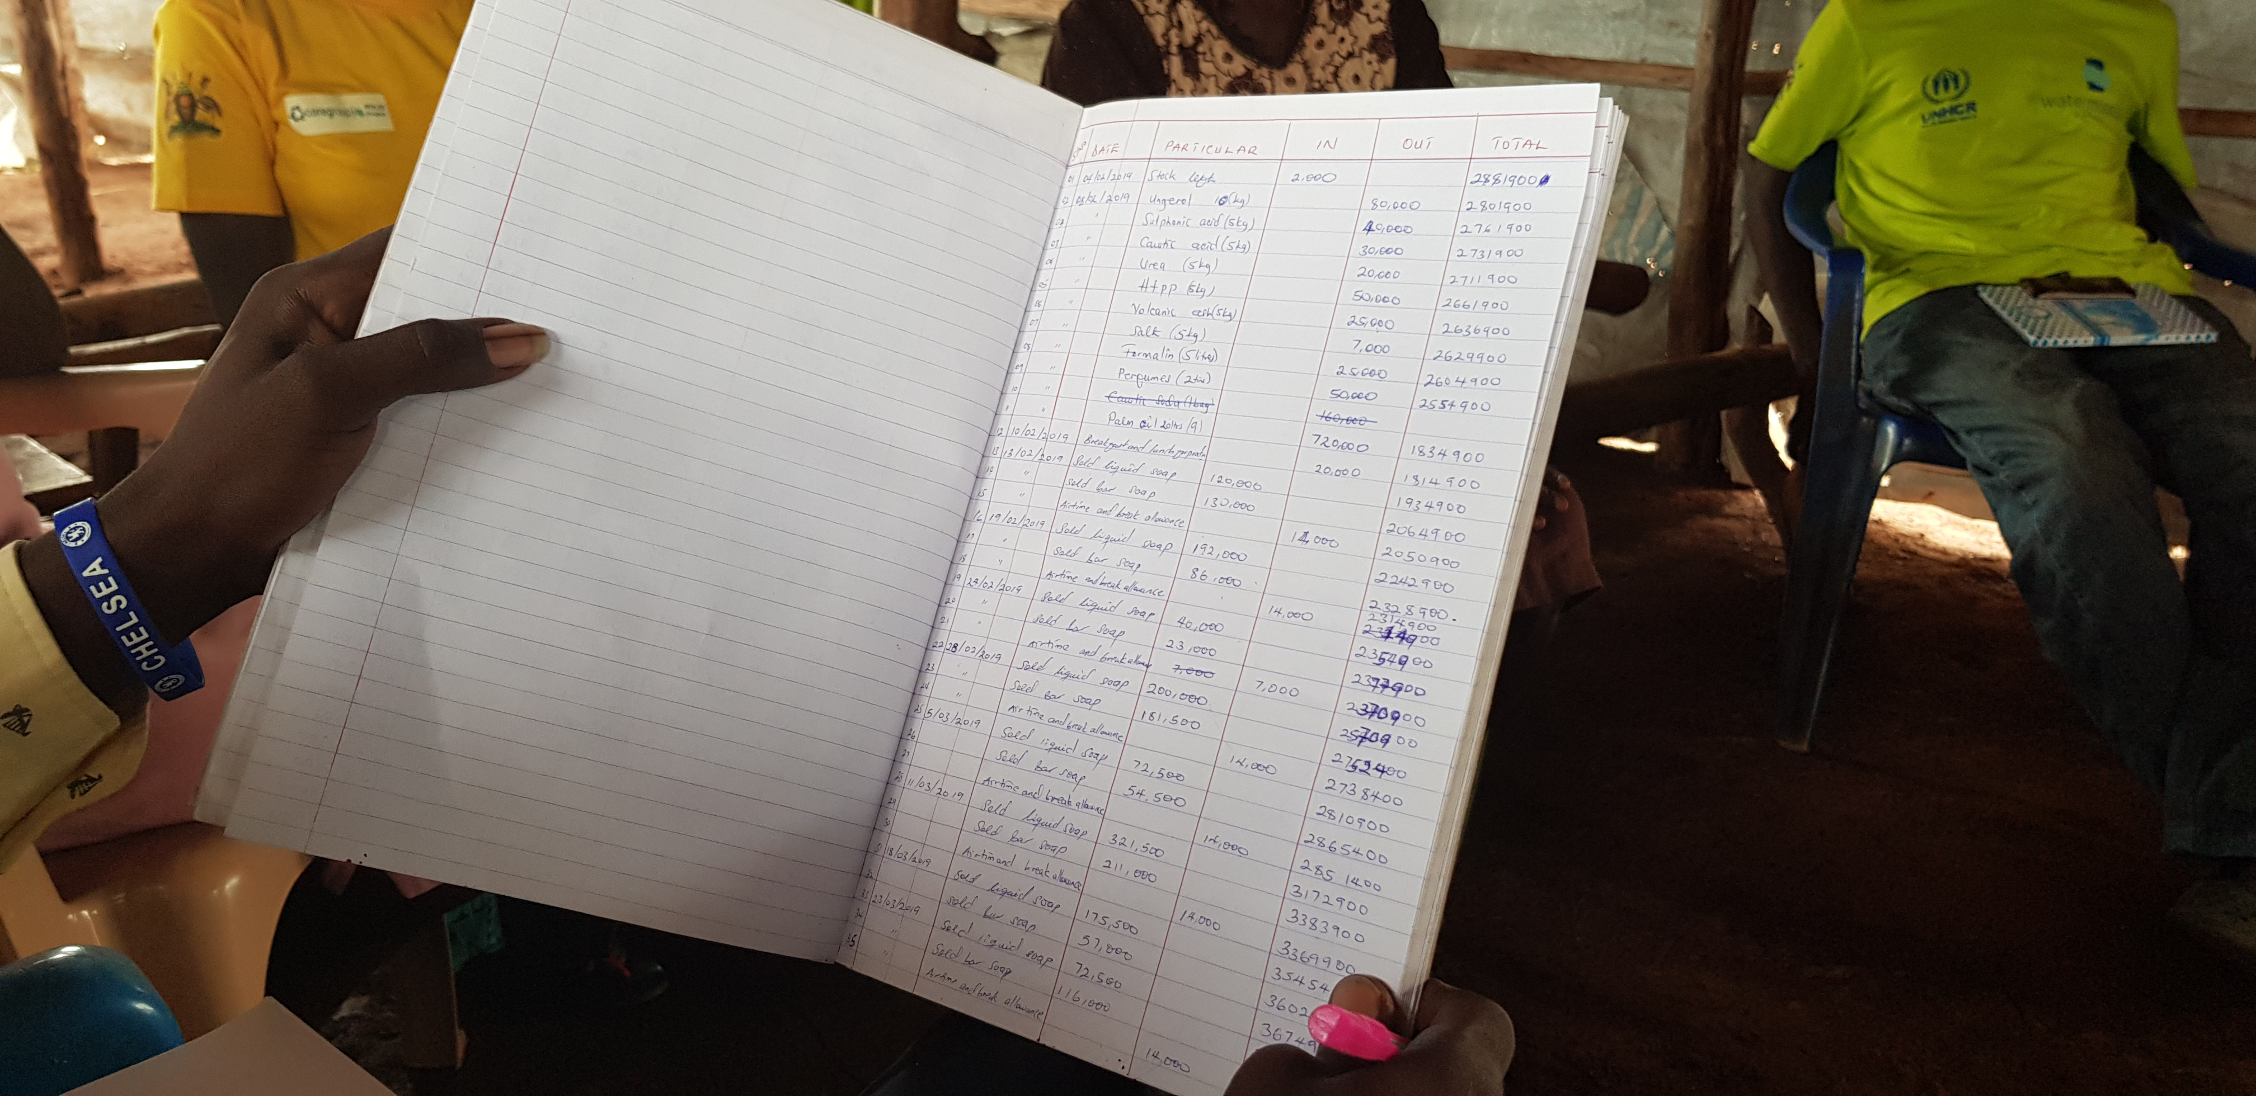
Pagirinya Social Enterprise Group
Combined men and women’s group: 12 members
11 successful businesses: group and personal savings, clinic, social services fund and celebrations fund:
“I have treated 1000 men and women and children with a variety of illnesses including malaria. Typhoid, flu, cough, brucella, ulcers, peptic ulcers, monitoring of illnesses. We don’t treat maternity health problems and we refer to the Health centre 2 for one to one counselling. There is no group counselling at the clinic”. (Male refugee)
Positive forum for sharing problems and tackling Sexual and
Gender-Based Violence
Notes:
When we returned men and women refugees had decided to join together in one group to support each other
11 businesses: generated more money than at start-photo of finance officer showing us their financial book keeping
One refugee who was a Medical Officer in South Sudan had opened a pharmacy clinic Read quote
SGBV incidents and security concerns still occurring in settlements refugees utilised their group to share, support each other and problem solve challenges

Slide 7
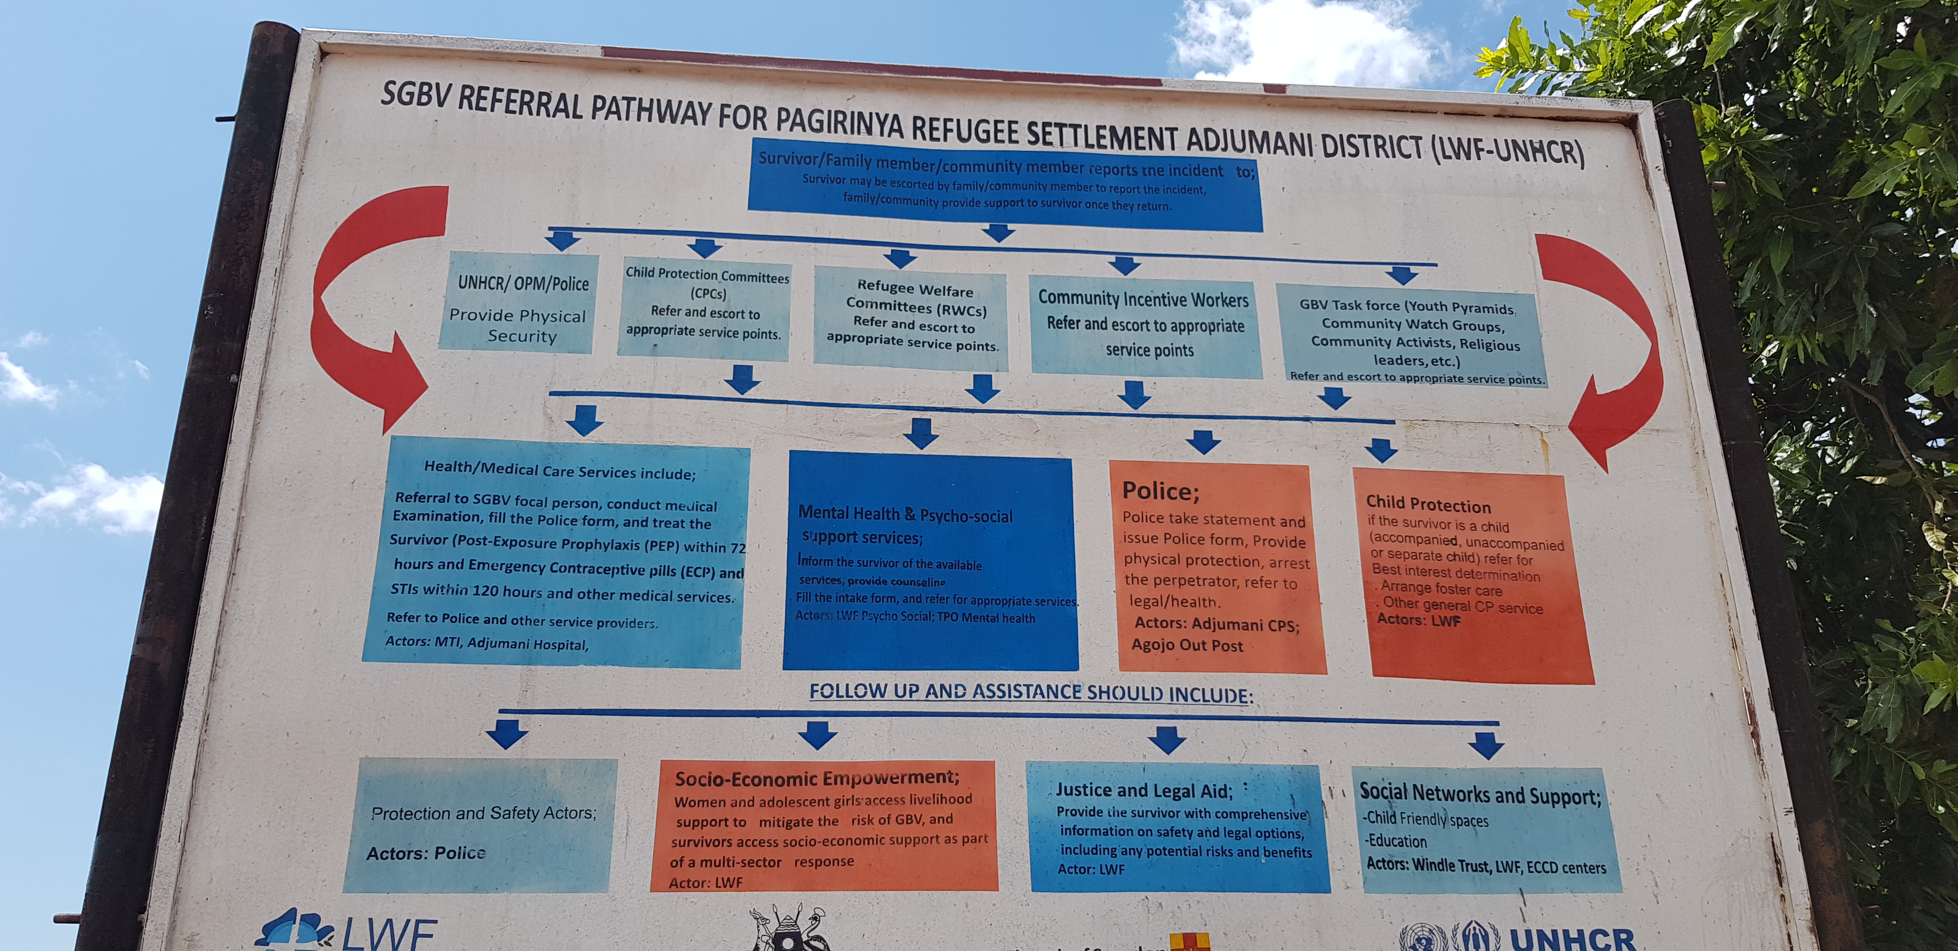
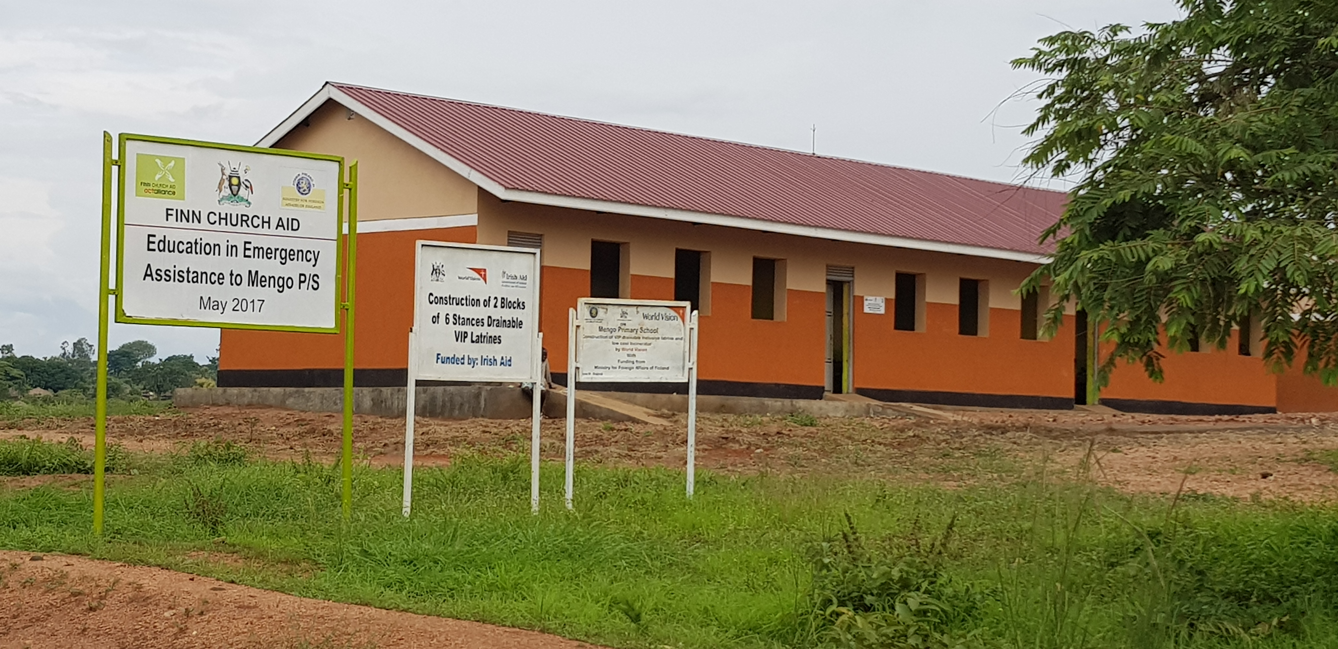
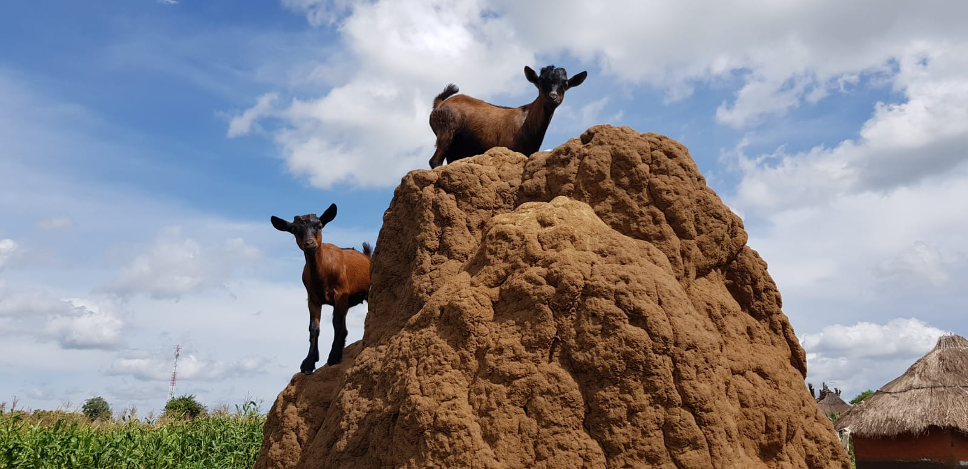
Mungula Women’s Social Enterprise Group
5 women: Petty trade, harvesting, goats: savings and loans
“I thank God you came to us as we were traumatised and could not get what we want or help ourselves. We are now able to help ourselves and buy clothes, soaps and body oil”
“The young girl group member who had been raped and had a child as a result is doing well and is in school. UNHCR called her to take her to St Mary’s school and she is interacting with other people now when she used to isolate herself which is really good considering the trauma she has been through”.
Positive forum for tackling problems, increasing resilience and supporting families
Notes:
Started with selling vegetables at the side of road; too much competition and getting little money so changed to breeding goats-(see photo) Generated more money than started with. Women kept the goats for a while. The goats produced off spring and these were distributed to the families. They used some for milking, some were sold and some were kept for breeding. They then exchanged them for cattle. Read quotes
Positive forum for tackling problems increasing resilience and supporting families and also tackling stigma and shame: counselling each other and refugees outside group

Slide 8
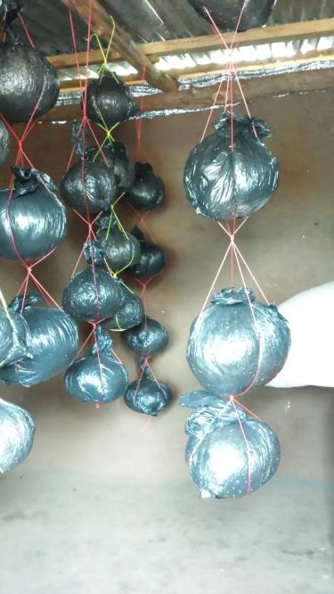
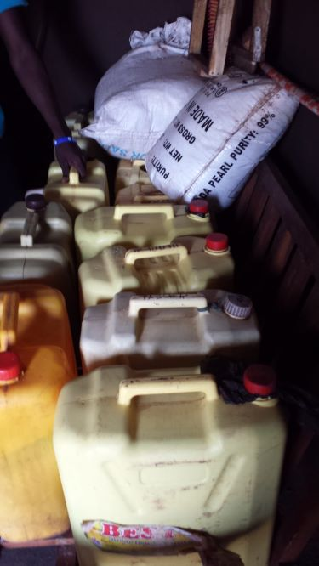
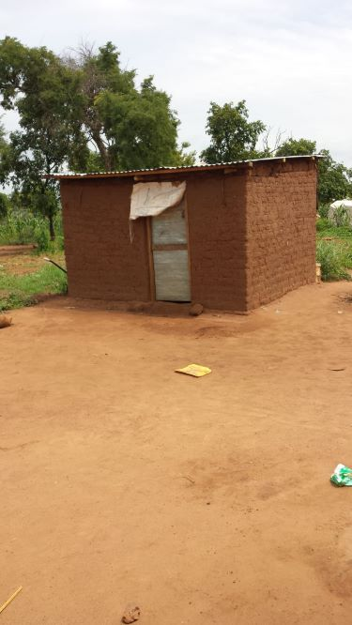
Bidi Bidi Social Enterprise Group
18 men and women: Selling soap and growing mushrooms: savings and loans
“I have seen the activities with my eyes and I tell the Office of the Prime Minister about it. I keep engaging the members so they continue growing as a group. The social enterprise has created love and sharing and our trauma has been pushed down.” (Male Chairperson)
“Thank God as before you came I had many problems and was not sleeping at night as I would think about the atrocities in South Sudan. Since we started the social enterprise we are now physically okay and smart and I thank you for taking the time to visit us.”
(Woman refugee)
Positive forum for tackling problems, increasing health, managing trauma
and skills building
Refugees valued opportunity to narrate
experiences: validating: restored hope
& dignity
Notes:
Read from my book: “We returned to Uganda nine months later with my friend Clarissa and were pleased to learn that all the social enterprise groups had gone well. The refugees felt they were beneficial to their ability to earn an income, care for their families, and support each other. Refugees also showed us their social enterprise groups, and we visited the mushrooms being grown in Bidi Bidi and the soap they were making and selling (Photos). We also visited the medical clinic. Read quotes then positive forum for tackling problems; found model for social enterprises very beneficial: Read refugees valued….
Ability to run and implement business increased for men and significantly increased for women
Significant improvement for men and women in income generation skills and provide income for family
Ability to care for emotional needs of family significant for men & women and women only
Resilience, empowerment and dignity in men and women improved significantly

Slide 9
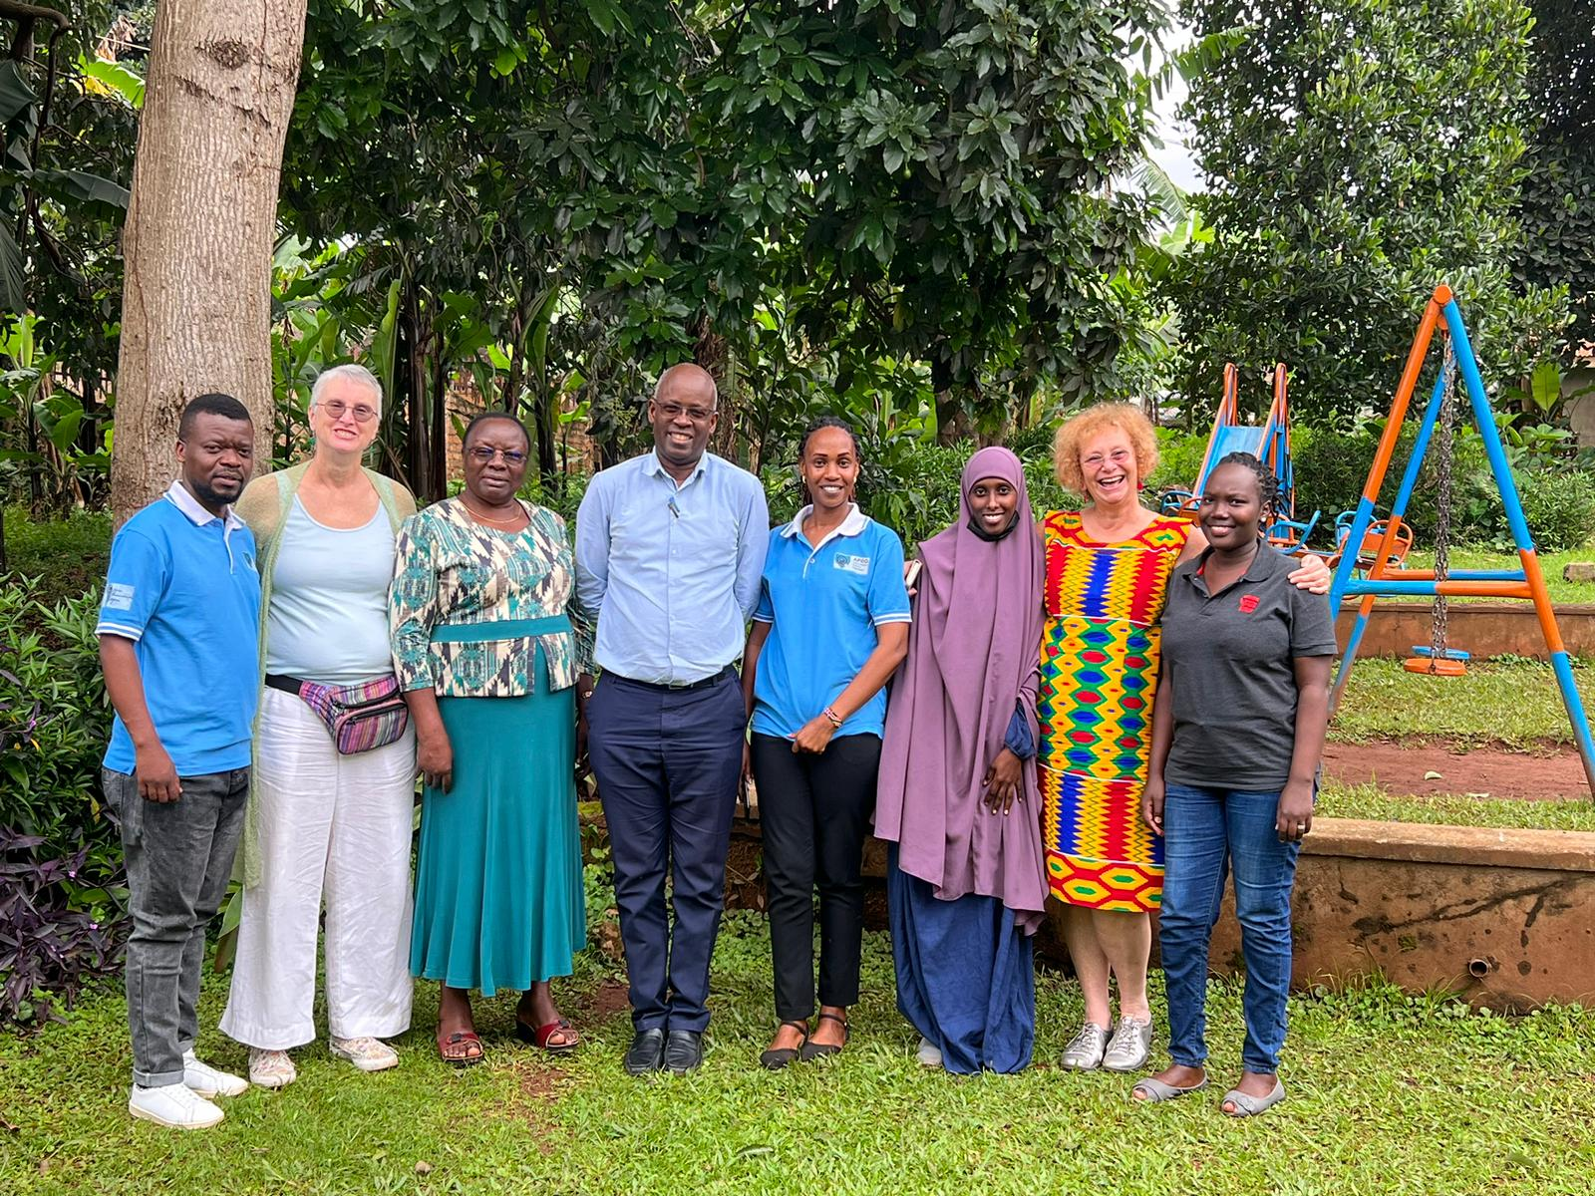
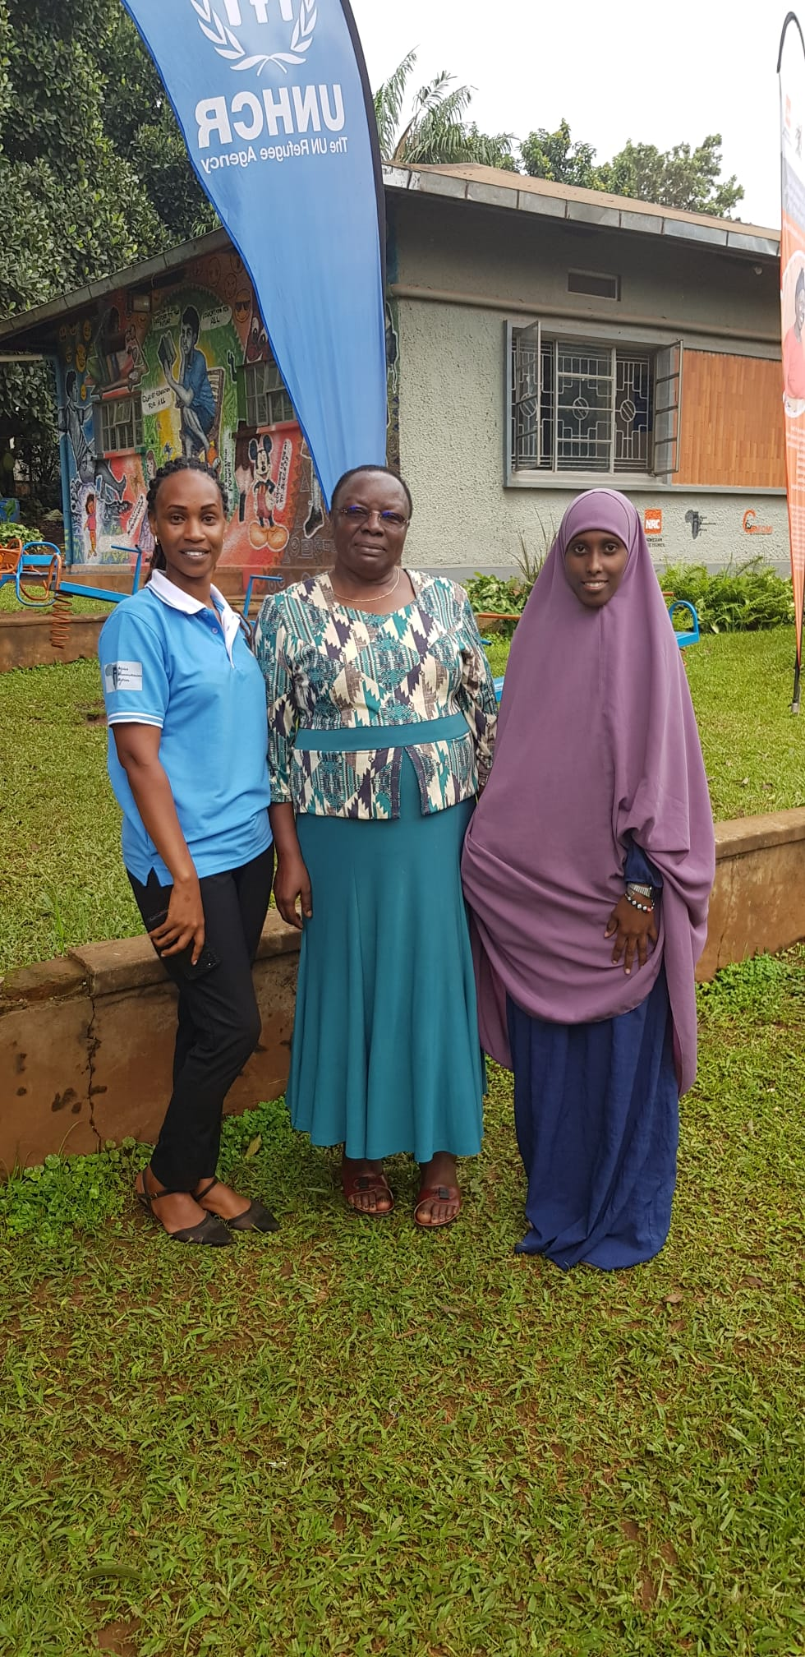
CLAMP REFUGEE PROJECT
Funding to establish CLAMP project: extending support to urban refugees in Kampala utilising integrated model and including peer refugee counselling as well as social enterprise groups
https://globalcompactrefugees.org/news-stories/clamp-bringing-mental-health-and-psychosocial-support-urban-refugees
Notes:
We also obtained funding to establish the CLAMP refugee project which started 1st September 2019 and provides counselling and support for urban refugees living in slums in Kampala they receive no funding from anywhere else. Able to do this through my friend Clarissa (show photo 2nd from left) originally set up through her father’s will and now from her mental health clinic funds in USA.
Project run by Ugandan team (see photos Dr Eugene Kinyanda and refugees) together with urban refugees from Somalia, Congo and Burundi who have been trained as peer counsellors and employed through the project.
I am very proud that despite limited funding project really making a difference to refugees lives and UNHCR cited it as a model of good practice: you can read more at the link at bottom of slide.

Slide 10
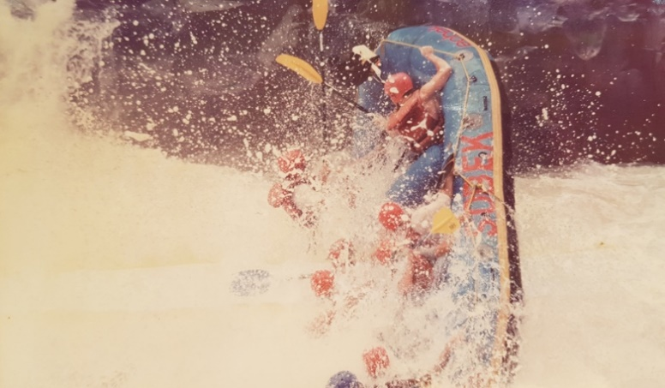
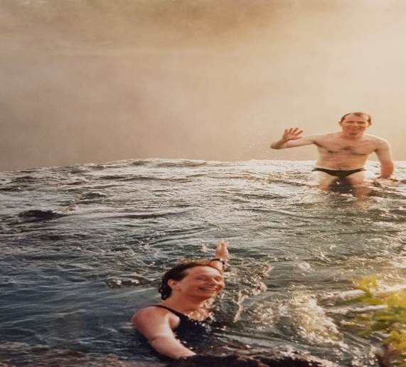
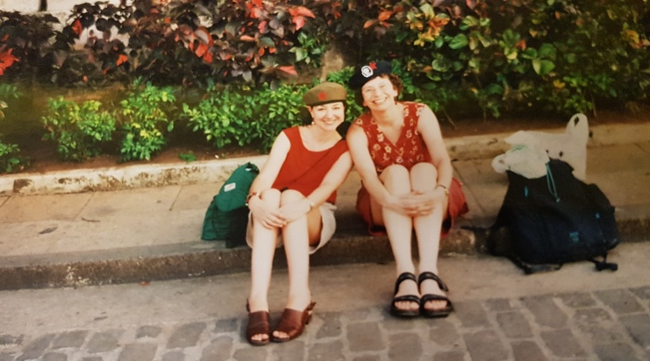
Travels
NEPAL
CUBA
ZIMBABWE
ZAMBIA
SOUTH AFRICA
BELIZE
White water rafting in Zambezi River
Ali and I in Havana, Cuba
Me and Leo swimming on top of
Victoria Falls (Devil’s Pool) in Zambia
Notes:
My autobiography describes fun and adventures whilst travelling in different countries including:
Nepal
Cuba where we experienced traditional music-friend Ali used to work in library service who I know from Samba band
Zimbabwe-photos where we did white water rafting
Zambia where I swam on the top of Victoria falls
South Africa
Belize

Slide 11
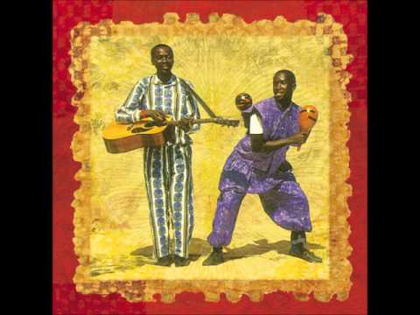
‘BERNARD’ A CHICKEN ON THE BUS
OLUGENDO
Notes:
Read from book about a good friend and musician Bernard Kabanda (CD-The Trip) who I used to perform music in bars with when I worked in Uganda. Bernard sadly died in 1999. I travelled with his co musician Bakka to visit his mother: READ BOOK
“I first met ‘Bernard the chicken’ when he came squawking and flapping into my arms from Bernard’s mother. He was a present, despite her being so poor. This really touched me. As Bernard the chicken lay in my arms, I did not have the heart to tell Bernard’s mother that I was a vegetarian and did not in fact eat chicken. Bakka and I named the chicken on the bus on our way back from his mother’s house: ‘What shall we call him?’ I asked while sitting with the chicken on my lap. ‘Let’s call him Bernard, in honour of our friend who died,’ responded Bakka. The matatu was made even livelier by me, Bakka, and Bernard strutting down the bus. The chicken chattered between us on the back seat, much to the amusement of the other passengers. They seemed amazed to see a mzungu (white person) carrying a chicken all the way to Kampala. Bernard got up to all kinds of exploits, flapping about, jumping under the seats, nibbling people’s toes, and squawking at the top of his voice. This reminded me of the human Bernard’s excitement when Peter Gabriel had asked him and Bakka to record a CD at his studios. Their song Olugendo Lw’e Bulaya (The Journey to Europe) was played during the film Hotel Rwanda and can still be found online today. I had been glad to see Bernard’s mothers face light up when I had handed over the hard-earned money from the CD sales, and Bernard (the chicken) jumped about as if to acknowledge her joyousness and relief that it had been too late for Bernard to spend it all.

Slide 12
‘BERNARD’ A CHICKEN ON THE BUS
Notes:
I noticed Bernard’s hopping around the bus and the movements were rhythmically in beat. Just like the real Bernard, who would strut his stuff to the delight of huge audiences.
After six bumpy, fun-filled hours, all of us were covered in dust. Bakka started to get off the bus, as we had arrived in ‘crazy’ Kampala Bus Park, so I hastily said, ‘Hey, Bakka, you’d better take Bernard since I’m a vegetarian.’ Bakka smiled, as did the others on the bus, and mumbled: ‘Muzungu Nalule kwogera Luganda,’ meaning ‘the white woman called Nalule speaks Ugandan.’ Every time I saw Bakka afterwards, I would ask after our friend Bernard, and he would remark; ‘Bernard’s getting fat’; ‘Bernard’s getting fatter’; ‘Bernard’s really fat now’. I smiled to myself, as Bernard had been so thin in real life. I considered it ironic as fatness in Uganda was considered a sign of health and wealth. Then one day, I asked Bakka, ‘Have you eaten Bernard yet?’ He replied, ‘No, Nalule, I do not have the heart to eat our friend.’ Sometime later, I asked after Bernard, and Bakka smirked. ‘You won’t believe it,’ he said, ‘Bernard escaped.’ I smiled to myself. Well, there you go, I thought. Bernard got the last laugh by escaping being eaten so he could continue strutting his stuff like he always used to”

Slide 13
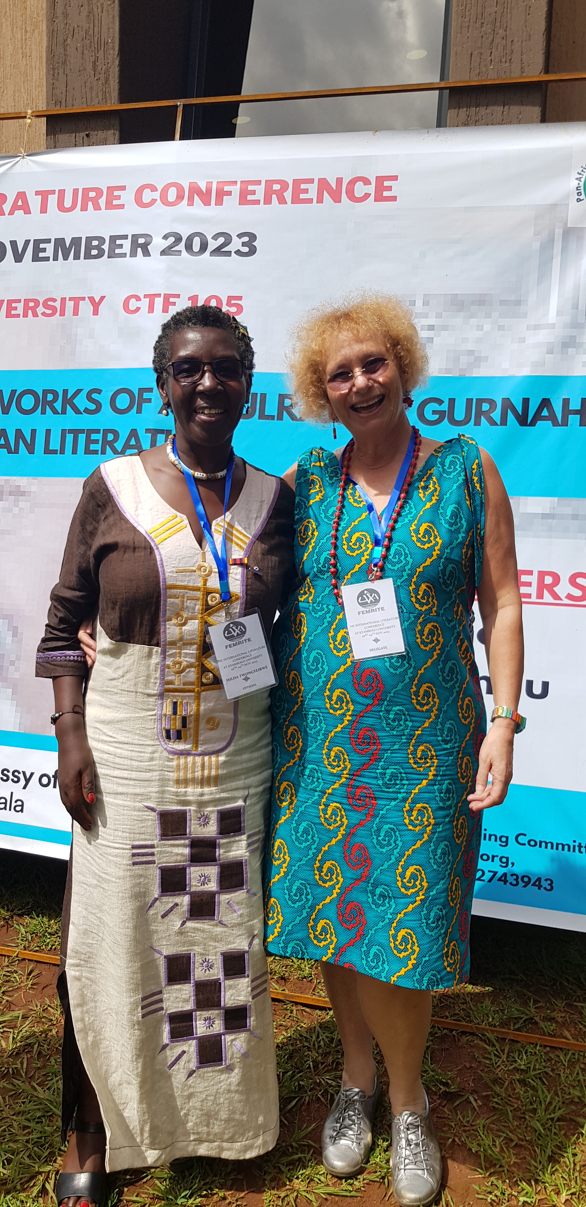
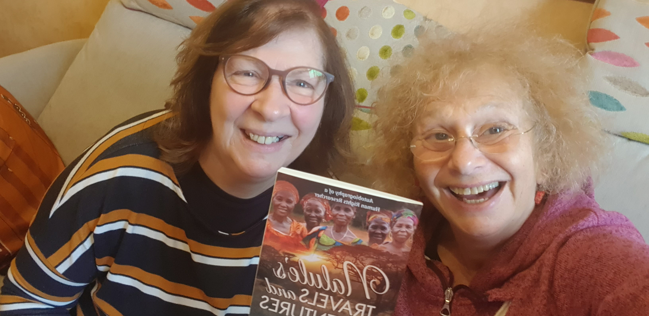


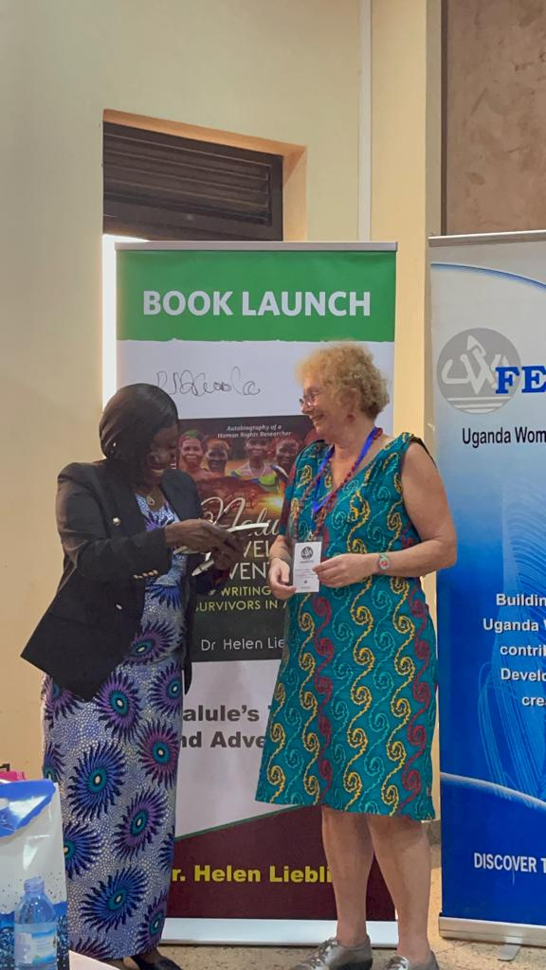
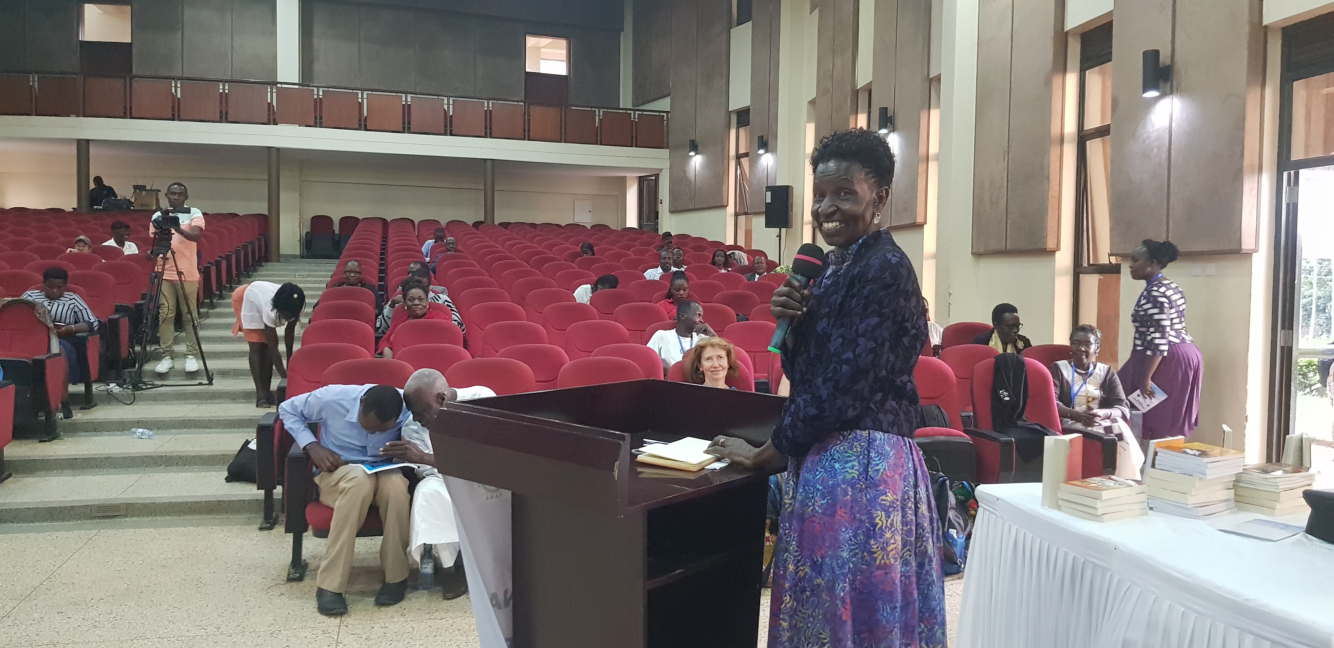
Thanks for listening!
ANY QUESTIONS?
Chris, Chair Inkplotters and I
celebrating book publication
Hilda, FEMRITE women writers and Helen at Book Launch, Uganda
Ruth, Director for Uganda, Women
Regional Network East Africa giving talk at book launch
Rachel Magoola MP Uganda, Guest of Honour at Book Launch
Website:
https:://helenliebling.com/
Contact details:
helenliebling@gmail.com
Notes:
Thanks very much for listening
Autobiography published by Aurora House in Australia
Grateful for their interest, enthusiasm and support including website support from India
Thanks Ink plotters writing group for feedback and support (some whom here) special thanks to Chris (see photo) for reading all my chapters
Thanks to all my colleagues and survivors in Africa without which none of the progress we made during our work would have been possible; I remain humbled to work with them all. Photos see Ruth Ojiambo-Ochieng, Hilda Twongwirwe, and Rachel Magoola at the book launch. I was honoured to launch my book together with 3 African authors (Kamilo Ka Lawino, Egara Kabaji Kenya and Taban el Tablaz Nassur) at a literary festival organised by FEMRITE women writers association in Uganda in November 2023. Life and works of author from Zanzibar Abdulrazak Gurnah,
Book can be bought on Amazon, Blackwell’s, Waterstones and more! More details on website which also has interviews and a book review, sections about my work, other books and tips and resources for writers
Very happy to sign books
Happy to be contacted on e-mail-please do take a leaflet and/or put name down to receive copy of talk
Are there any questions?

