Slide 1
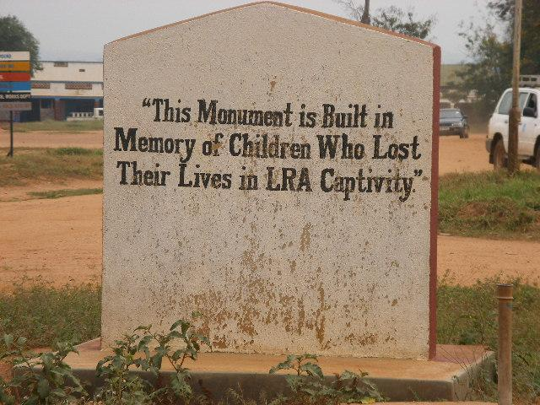
NALULE’S TRAVELS AND ADVENTURES:
WRITING FOR SURVIVORS IN AFRICA
DR HELEN LIEBLING
Abdulrazak Gurnah Literary Conference, Kyambogo University, Kampala, Friday, 24th November 2023
Notes:
Many thanks for inviting me: Title and explain Nalule
Dr Helen Liebling, former clinical lead of refugee services in Coventry NHS-retired last year: currently work as Assistant Professor in Research and Clinical Psychology in Research Centre for Trust, Peace and Social Relations, Coventry University and a founding member of African Psycare Research Organisation (APRO) who carry out research and provide services for survivors.
Warning about sensitive content: important to highlight voices of survivors and service providers working with to validate their experiences and improve service responses
Photo of monument taken in Northern Uganda where we carried out research with girl and boy children who fled abduction by the Lord’s Resistance Army, a rebel group. The children were forced to commit atrocities against their own communities and others and also survived appalling human rights abuses. Pleased to say that our research recommendations from this project were taken to the President of Uganda who stated he would discuss these with the Ministry of Health and his Security Council.

Slide 2
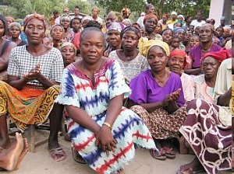
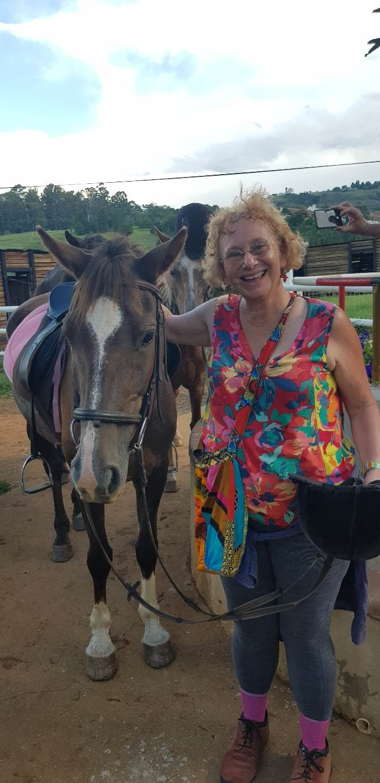
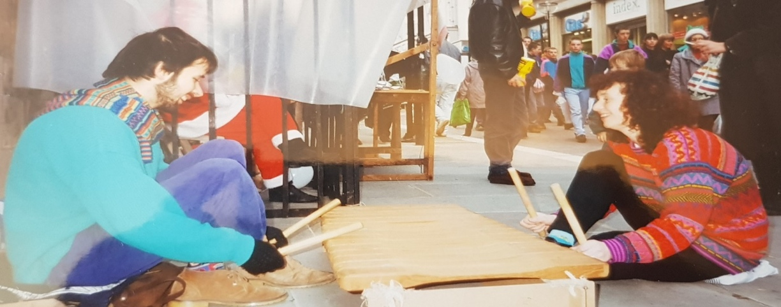
CONTENT
EARLY LIFE Liberian Women Conflict Survivors
WORK WITH CONFLICT SURVIVORS
TRAVEL
MUSIC
A CHICKEN ON A BUS
Playing Amadinda (Ugandan xylophone) for
Amnesty International
Horse riding in Drakensburg
Mountains, South Africa
Notes:
Time for questions and discussion at the end

Slide 3
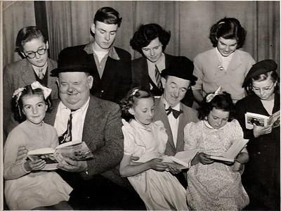
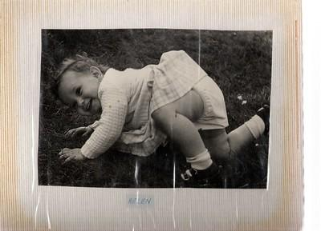
EARLY LIFE
FAMILY DISRUPTION
FATHER JEWISH
MOTHER CHRISTIAN
Mum (3rd from left back row) being awarded
a prize for painting by Laurel and Hardy
Me as a baby
Notes:
Father Jewish and Mum Christian. Father’s parents wore black and wouldn’t speak to us for 2 years when married: divorced when 13: responsible for caring for brother, sister and mother
Family separation and Jewish ancestry led to passion for advocating for rights of those who survived human rights violations
Both parents remarried relied on friends throughout my life (refer to picture of Mum): Read Autobiography……
One early memory was the excitement of going to my Jewish cousin Kevan’s Bar Mitzvah, to celebrate as he ‘became a man’ in Jewish faith at thirteen years of age. My mother insisted on getting myself and my sister Ruth matching hot pants, which I quite liked. However, she then presented me with a bright pink dress, which I hated with a vengeance. The Bar Mitzvah weekend event was extremely exciting; about one hundred relatives who lived in America arrived, and it took place in a large hall buzzing with interesting characters whom I had never met before.
My cousin Kevan was a similar age to me, and I got on with him well. I was impressed to hear him read in Hebrew at the ceremony in the synagogue. The afterparty was the best part, with brilliant music, dancing, and enjoyment. At the event, my brother Jonathan ­– who must have been about six years old – suddenly ran to the front, grabbed the microphone off the presenter, and started singing Show Me the Way to Go Home. Everyone fell about laughing.
I thought he was very brave for doing so in front of so many relative strangers. The whole weekend experience made me wish I was Jewish. I felt so much sympathy for how the Jewish people had suffered during Hitler’s regime and the Holocaust, and I felt a real sense of belonging amongst all the lively relatives I had discovered. However, at the same time, I wondered how I would manage the strictness that Jewish traditions appeared to involve.

Slide 4
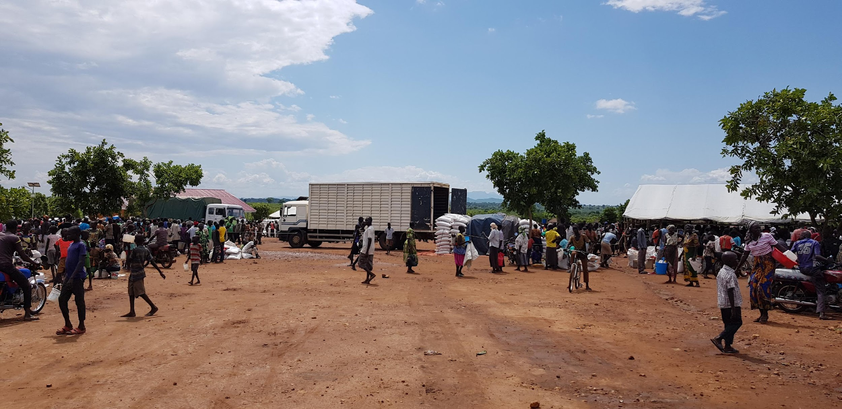

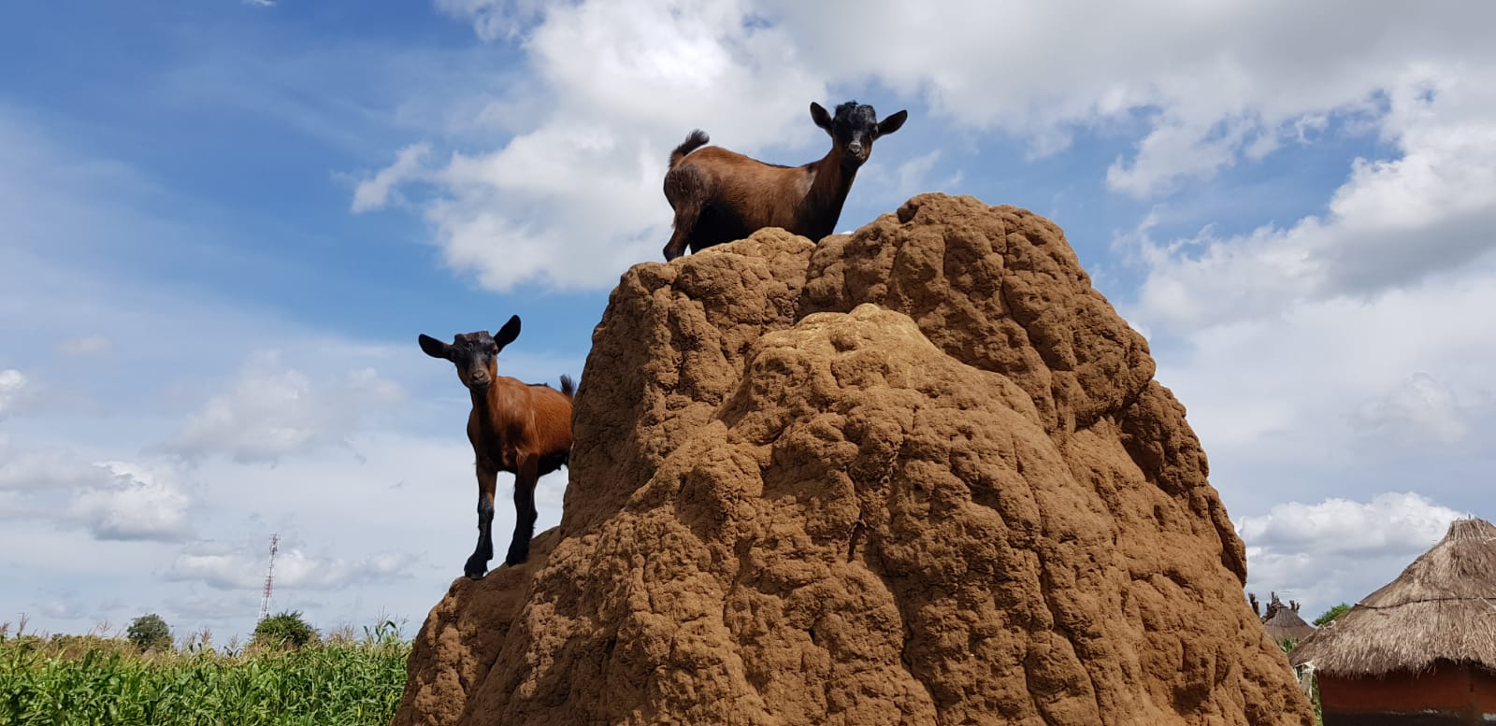
WORK WITH CONFLICT SURVIVORS
TRAVEL TO UGANDA TO RECORD TRADITIONAL MUSIC
SET UP CLINICAL PSYCHOLOGY COURSE
PhD: ‘A GENDERED ANALYSIS OF THE EXPERIENCES OF UGANDAN WOMEN WAR SURVIVORS’
Delivery of food rations in Bidi Bidi Refugee Settlement
Goats in Northern Uganda
Notes:
Travelled to Uganda with Peter, an ethnomusicologist from Edinburgh University and Andy, his son and my former partner who was teaching me traditional Ugandan music in 1992 to record music in Busoga, East-happy to play a thumb piano song at the end if any wishes me to?
As requested by Ugandans at Makerere University, I set up first Clinical psychology course in East Africa through British Council link; I worked as Senior Lecturer there in 1987-1988
Whilst working in Uganda invited by Women’s International Peace Centre: intervention to provide medical and psychological assessment and treatment for women conflict survivors in Luwero District; WIPS document narratives of women and girls internationally and campaign with governments to improve support for survivors and have over 200 organisations in rural areas across the world
I returned to UK with my PhD ideas written on a piece of A4 paper (Leeds then Warwick met Caroline) PhD title-see my research as action research-try to make a difference: Conflict between Museveni and Obote: Luwero base camp: men forced to fight: women heads of households
Implemented recommendations: bore well (Dad rotary and Luwero engineers), medical intervention and goat breeding (Older feminist network funding S Wales)
Several research projects in collaboration with African partners to assist conflict survivors of SGBV and torture and try to improve service responses
Uganda: Former LRA abducted children Governance of Sexual Violence, trauma centres evaluation (services established using recs of research) and South Sudanese refugees
Liberia: Women conflict survivors, research, consultancy and training
Rwanda: Experiences of trauma services by perspectives of genocide survivors and staff
Eastern DRC: Women and girls who bore children from rape: health and justice services
United Kingdom: Refugee research
Happy to answer questions about this work in discussion

Slide 5
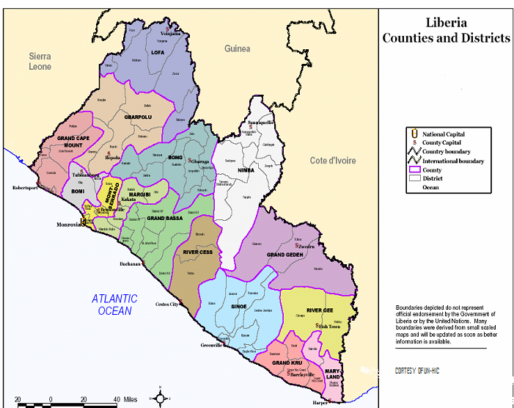
Notes:
Focus on work in Liberia in West Africa
Show where we carried out training in Harper and brought together participants from Lofa (top purple), Bong (green-below Lofa) Maryland and Grand Kru
Explain research and then move to next slide for quotation….

Slide 6
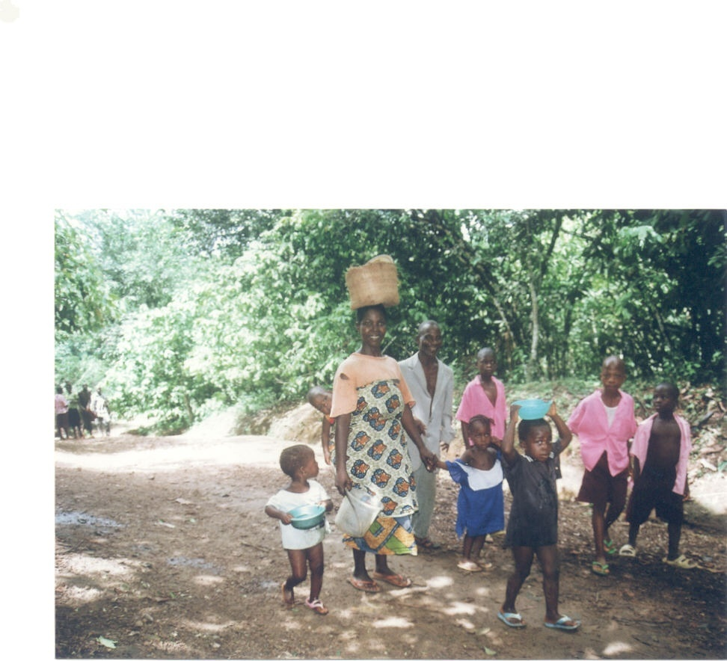
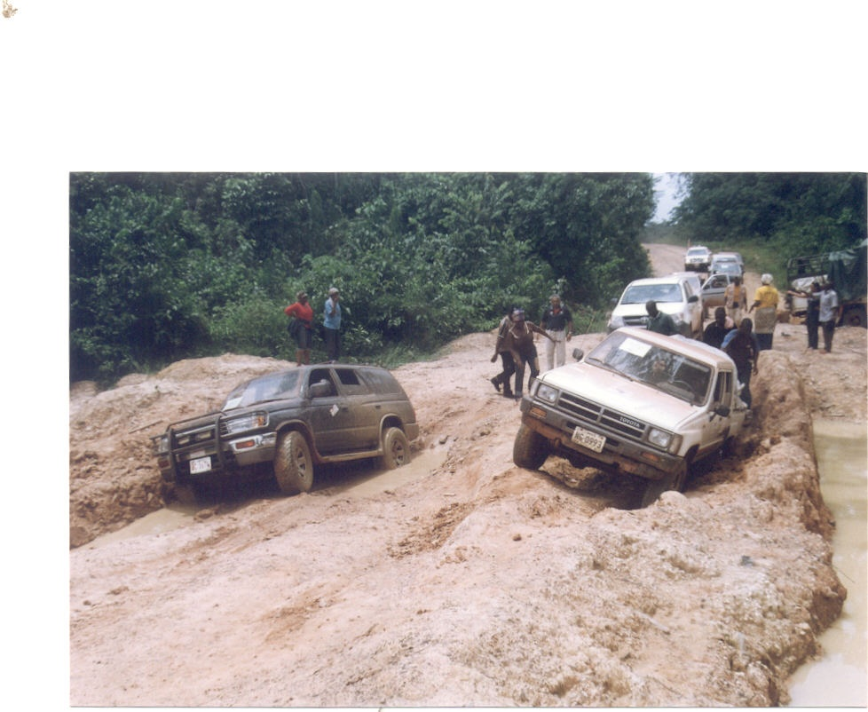
WOMEN SURVIVORS IN LIBERIA:
RESEARCH AND TRAINING
“ONE OF THE WOMEN I HAVE BEEN COUNSELLING WAS RAPED BY 7-10 SOLDIERS EVERY NIGHT FOR TWO WEEKS….SHE NOW FEELS USELESS AND WANTED TO COMMIT SUICIDE. SHE COULD NOT TELL HER HUSBAND AND THE CHILDREN”
(MALE COUNSELLOR IN MONROVIA)
Notes:
Reviewer and consultant for research with women conflict survivors in Liberia
Women’s activism brought in first woman Head of State in Africa, Ellen Johnson Sirleaf: November 2005 following the 14-year civil war
Head of state now changed and Liberia one of few African Countries to have held democratic elections
Partly due to militarisation, poverty and struggle for resources-12 armed groups attacked all counties led to forced displacement of population.
During the conflict armed groups carried out widespread torture and abuse: destruction of infrastructure and communication (see picture of road)
50% no access to health care: Lack of trained health workers:
High levels of brutality & displacement: serious effects on women & girl’s lives:
43% of women heads of households: active campaigners for peace
68.5% at least one gynaecological complaint: HIV/AIDS
Very high levels of stigma and shame: increased psychological effects:
Gynaecological problems more common in young women: HIV/AIDS escalated
Although upsetting like to read quote from male counsellor interviewed in Monrovia the capital during our research:

Slide 7
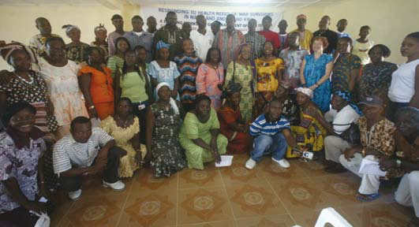
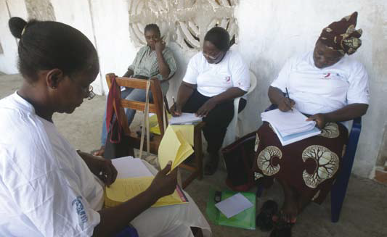
LIBERIA-CONSULTANCY
TRAINING IN HARPER WITH 70 PARTICIPANTS
BUILD CAPACITY OF COMMUNITY HEALTH WORKERS
IMPORTANCE OF HEALING REPRODUCTIVE AND PSYCHOLOGICAL HEALTH PROBLEMS
Training participants in Harper
Group work during training
Notes:
EU funded training designed based on “Understanding & Treatment of Medical and Psychological problems of War Survivors of Violence and Torture”
Build capacity of community health workers (many professionals left during conflict) in identification and treatment of health problems of survivors
Illustrate importance of healing reproductive and psychological health problems so survivors can engage actively in rebuilding their lives and communities
Read from book: The training was carried out in Harper, Maryland County, in May 2009. A total of 49 participants; 24 women and 25 men attended. It emphasised an integrated approach, which meant it included counselling and management of psychological trauma, sexual and reproductive health problems, supporting survivors of gender-based violence and human rights abuses, and professional standards in healthcare. As professionals involved were also conflict survivors, the training included individual and group counselling to model a way of professionals supporting themselves, which they could continue to use in their own communities after the training.

Slide 8
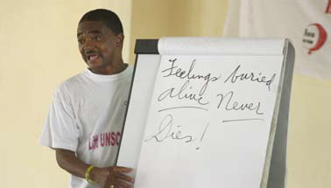
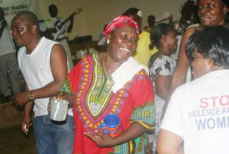
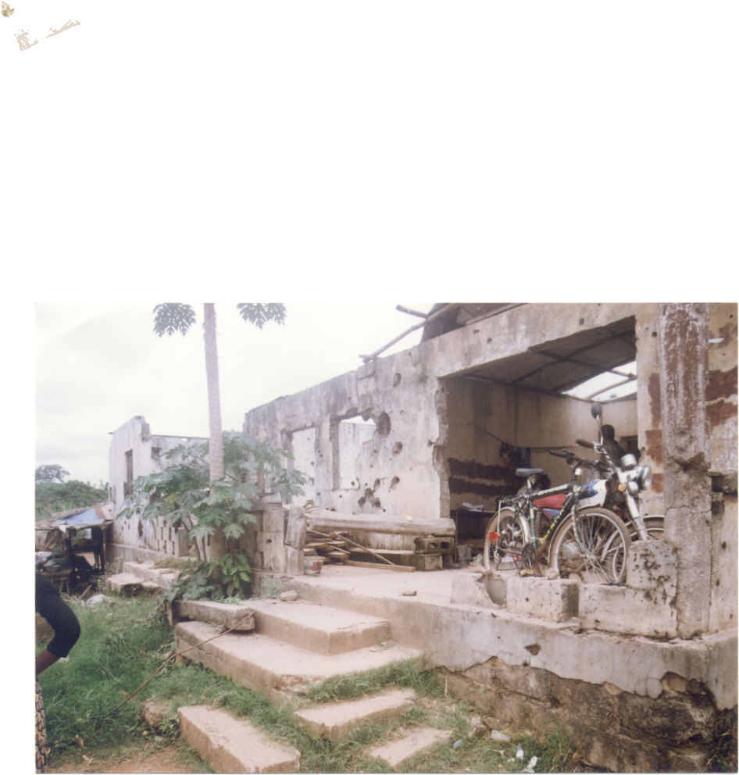
LIBERIA-CONSULTANCY
EVALUATION OF MEDICAL AND PSYCHOLOGICAL TREATMENT
SUCCESSFUL TREATMENT OF HEALTH PROBLEMS DECREASED STIGMA: INCREASED QUALITY OF LIFE
Psychologist emphasising self-care
Training participants sharing cultures
Broken down health centre
Notes:
Read from book:
We delivered urgently needed drugs and equipment to twelve health centres and two hospitals. The trained health workers, social workers, and community leaders conducted screenings of survivors. A total of 1,076 survivors – 685 women and 391 men – were seen for assessments by the team. The surgery focussed on sexual and reproductive health complications, including Vesicovaginal fistula (where tear between anus and vagina which causes leakage of urine and stool highly stigmatising), uterine fibroids, genital prolapses, and infertility problems. Some survivors had more than one surgical condition that needed treatment. A total of 207 survivors – sixty women and 147 men, ranging from one to ninety years old – benefitted from the surgical camp.
Due to the enormous numbers who accessed the services, the medical consultants and other staff volunteered extra hours. The heavy rains and the poor road infrastructure were a key challenge. It is also important to note that previous health programmes in this area had focussed on men, and most women assumed that this was still the case. Once women saw their fellow women benefitting from the programme, they came for treatment. Our evaluation showed those women and men who received successful treatment of their physical health problems reported a decrease in stigma and an increase in their quality of life.

Slide 9
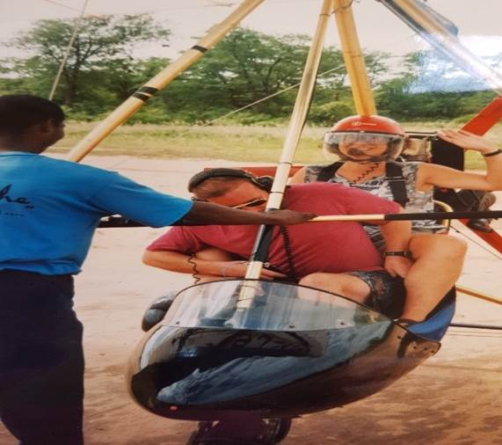
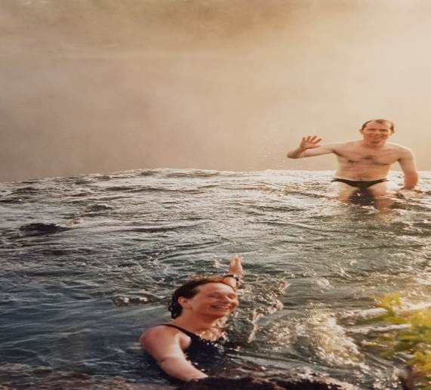
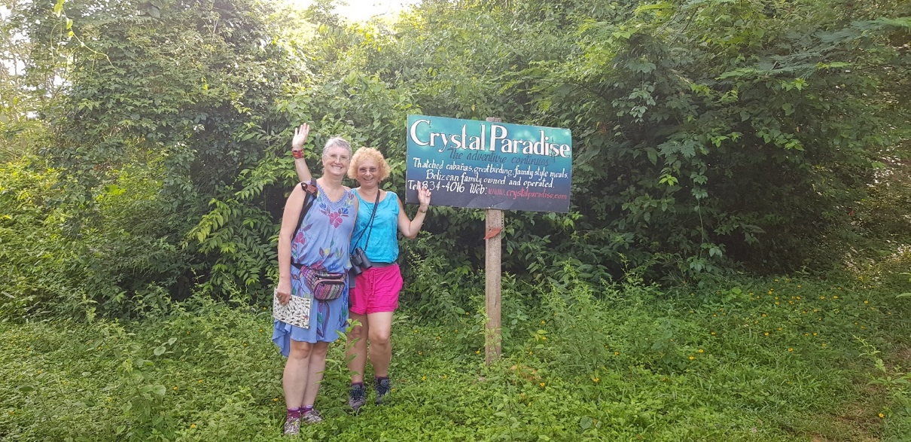
TRAVELS
NEPAL
CUBA
ZIMBABWE
SOUTH AFRICA
GREECE
ZAMBIA
Me flying in microlight over Victoria Falls
Clarissa and I in Belize
Me and Leo swimming on top of
Victoria Falls (Devil’s Pool) in Zambia
Notes:
My autobiography describes fun and adventures whilst travelling in (read list of countries) but due to time I have chosen to focus on a book reading about Zimbabwe
Ali who is my travel companion in the Cuban photo came to Uganda with me in 1996

Slide 10
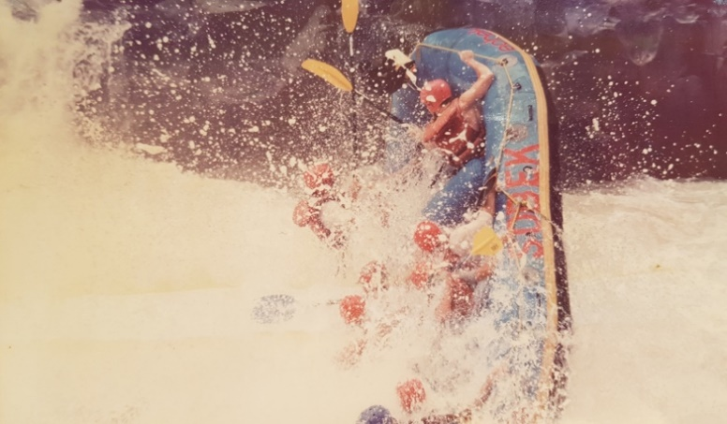
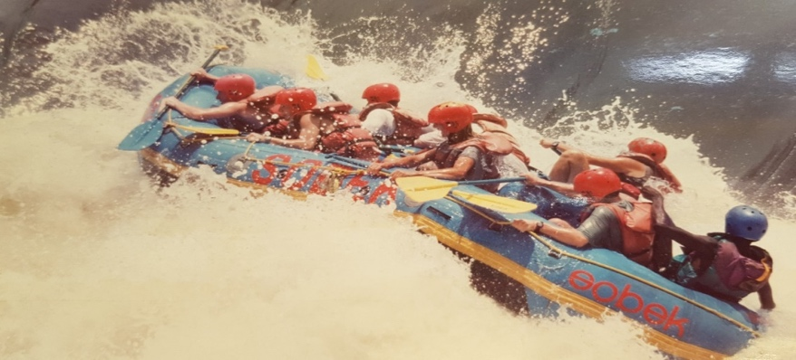
ZIMBABWE
Notes:
Travelled with good friend to Bulawayo and took the train to Victoria Falls.
Read from book: When we reached Victoria Falls, we decided to try White Water Rafting. Each time we fell out of the boat, it felt like I was going to drown. I was practically cartwheeling into the water, as though we were being spun around in a washing machine with no hope of ever reaching the surface for air. There were also crocodiles in the river, and when I finally reached the surface to take a breath, I saw that none of my other boat friends could be seen, or the boat for that matter.
A person on a kayak came up and asked if I was okay. I answered, ‘No, not really,’ after swallowing what seemed like half of the Zambezi River. They pulled me back to the boat, where I was lifted back in only for the boat to capsize again at the next rapids. I do not know how we survived the day, as I was sure I was going to die, but we did. We later discovered that two boat-loads of people had been killed two weeks previously, which did not surprise me. After we had endured the day’s excitement, a photographer approached enthusiastically, saying: ‘Look at this, isn’t it brilliant?’ I cast my eyes down to the photograph he was showing me and saw that it was an amazing picture of our boat getting catapulted far into the air at a ninety-degree angle to the water below. I saw that all of us were captured in mid-air falling backwards out of the boat, suspended above the water. I thanked him very much for the picture and understood why I had thought I was on the verge of death. (unfortunately I have been unable to locate this actual picture but found others)

Slide 11
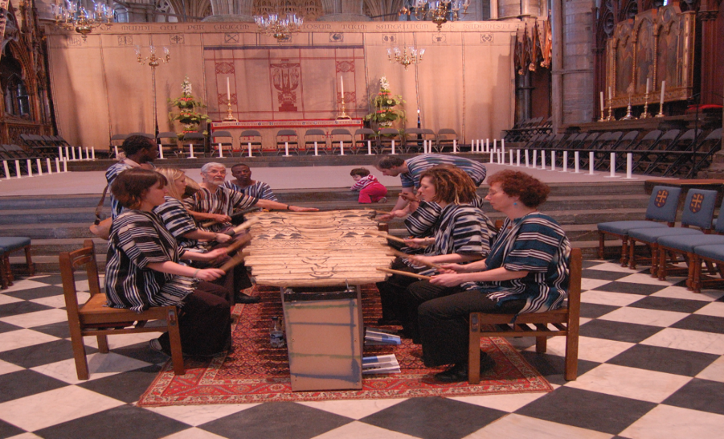
MUSICAL ADVENTURES
PRACTICING EMBAIRE FOR WESTMINSTER ABBEY PERFORMANCE FOR QUEEN’S JUBILEE
Notes:
I was asked by Mugwisa, the xylophone maker, to go into the banana plantations, where I was met by the leaders of the group as well as a live chicken – squawking aggressively as if it knew something was about to happen. One of the musicians held the chicken and suddenly cut its throat. Blood spurted everywhere. Oh, I do not much like this, I thought, being a vegetarian. The musicians poured the remaining blood on the middle key of the xylophone. ‘Why do you do this?’ I asked quizzically, and Mugwisa replied. ‘Whenever we make a xylophone, we pay our respects to the elders who started the xylophone-making tradition in this village. We pour blood on the middle key to give the xylophone its heart, otherwise it will not sound good.’ ‘Oh, I see,’ I said, feeling very privileged to learn the history of this musical tradition in Busoga. ‘What do you kill if I buy a twenty-one key embaire?’ (see in the photo) Mugwisa laughed. ‘A goat,’ he replied with a smile. I also smirked, although I did not approve of an animal being slaughtered. The wild music continued to celebrate the christening of my xylophone with eight energetic musicians. They sat over the instrument whilst frantically beating an octave with a stick in each hand, four musicians on one side and four on the other. The most amazing sound emerged from the interlocking tunes. The largest twenty-one key was so big that the musicians also used it as a drum, beating the centre with their hand whilst playing the xylophone at the same time (Peter photo/embaire brought)

Slide 12
MUSICAL ADVENTURES
Notes:
The embaire players were joined by other musicians shaking nsassi (shakers), and endingidi (tube fiddles) – a small African violin with one string and a flute player. The crowd got bigger and bigger, with people coming from all the surrounding villages. Screaming pierced the air as two male Ugandan dancers suddenly appeared wildly wiggling their hips and pelvises as fast as humanly possible. It was very sexy, energetic dancing. On occasion, they would move remarkably close to unsuspecting women in the crowd, who would look very embarrassed and then hand the dancers Ugandan schillings. Andy, Peter, and I became red in the face when the gyrating male dancers ‘shook their jigs’ in front of us. We all laughed in embarrassment and gave money, then joined in with the energetic hip wiggling much to the hilarity and screaming of the gathered crowd. After a couple of very enjoyable hours, the performance reached its climax and ended when it had become dark. We made our way back to Iganga, where we stayed for the night in a dubious hotel. We stopped for lunch on the way and listened to our recordings. We were all still feeling extremely excited and elated by the beautiful sounds, lively audience, musicians, bright colours, my embaire xylophone, and of course the mysterious chicken.
MUSICAL ADVENTURES

Slide 13
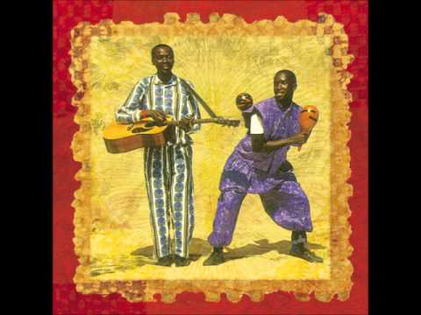
‘BERNARD’ A CHICKEN ON THE BUS
OLUGENDO
Notes:
Read from book about a good friend and musician Bernard Kabanda (CD-The Trip) who sadly died in 1999 and I travelled with his co musician Bakka to visit his mother:
I first met ‘Bernard the chicken’ when he came squawking and flapping into my arms from Bernard’s mother. He was a present, despite her being so poor. This really touched me. As Bernard the chicken lay in my arms, I did not have the heart to tell Bernard’s mother that I was a vegetarian and did not in fact eat chicken. Bakka and I named the chicken on the bus on our way back from his mother’s house: ‘What shall we call him?’ I asked while sitting with the chicken on my lap. ‘Let’s call him Bernard, in honour of our friend who died,’ responded Bakka. The matatu was made even livelier by me, Bakka, and Bernard strutting down the bus. The chicken chattered between us on the back seat, much to the amusement of the other passengers. They seemed amazed to see a mzungu (white person) carrying a chicken all the way to Kampala. Bernard got up to all kinds of exploits, flapping about, jumping under the seats, nibbling people’s toes, and squawking at the top of his voice. This reminded me of the human Bernard’s excitement when Peter Gabriel had asked him and Bakka to record a CD at his studios. Their song Olugendo Lw’e Bulaya (The Journey to Europe) was played during the film Hotel Rwanda and can still be found online today. I had been glad to see Bernard’s mothers face light up when I had handed over the hard-earned money from the CD sales, and Bernard (the chicken) jumped about as if to acknowledge her joyousness and relief that it had been too late for Bernard to spend it all.

Slide 14
‘BERNARD’ A CHICKEN ON THE BUS
Notes:
I noticed Bernard’s hopping around the bus and the movements were rhythmically in beat. Just like the real Bernard, who would strut his stuff to the delight of huge audiences.
After six bumpy, fun-filled hours, all of us were covered in dust. Bakka started to get off the bus, as we had arrived in ‘crazy’ Kampala Bus Park, so I hastily said, ‘Hey, Bakka, you’d better take Bernard since I’m a vegetarian.’ Bakka smiled, as did the others on the bus, and mumbled: ‘Muzungu Nalule kwogera Luganda,’ meaning ‘the white woman called Nalule speaks Ugandan.’ Every time I saw Bakka afterwards, I would ask after our friend Bernard, and he would remark; ‘Bernard’s getting fat’; ‘Bernard’s getting fatter’; ‘Bernard’s fat now’. I smiled to myself, as Bernard had been so thin in real life. I considered it ironic as fatness in Uganda was considered a sign of health and wealth. Then one day, I asked Bakka, ‘Have you eaten Bernard yet?’ He replied, ‘No, Nalule, I do not have the heart to eat our friend.’ Sometime later, I asked after Bernard, and Bakka smirked. ‘You won’t believe it,’ he said, ‘Bernard escaped.’ I smiled to myself. Well, there you go, I thought. Bernard got the last laugh by escaping being eaten so he could continue strutting his stuff like he always used to

Slide 15
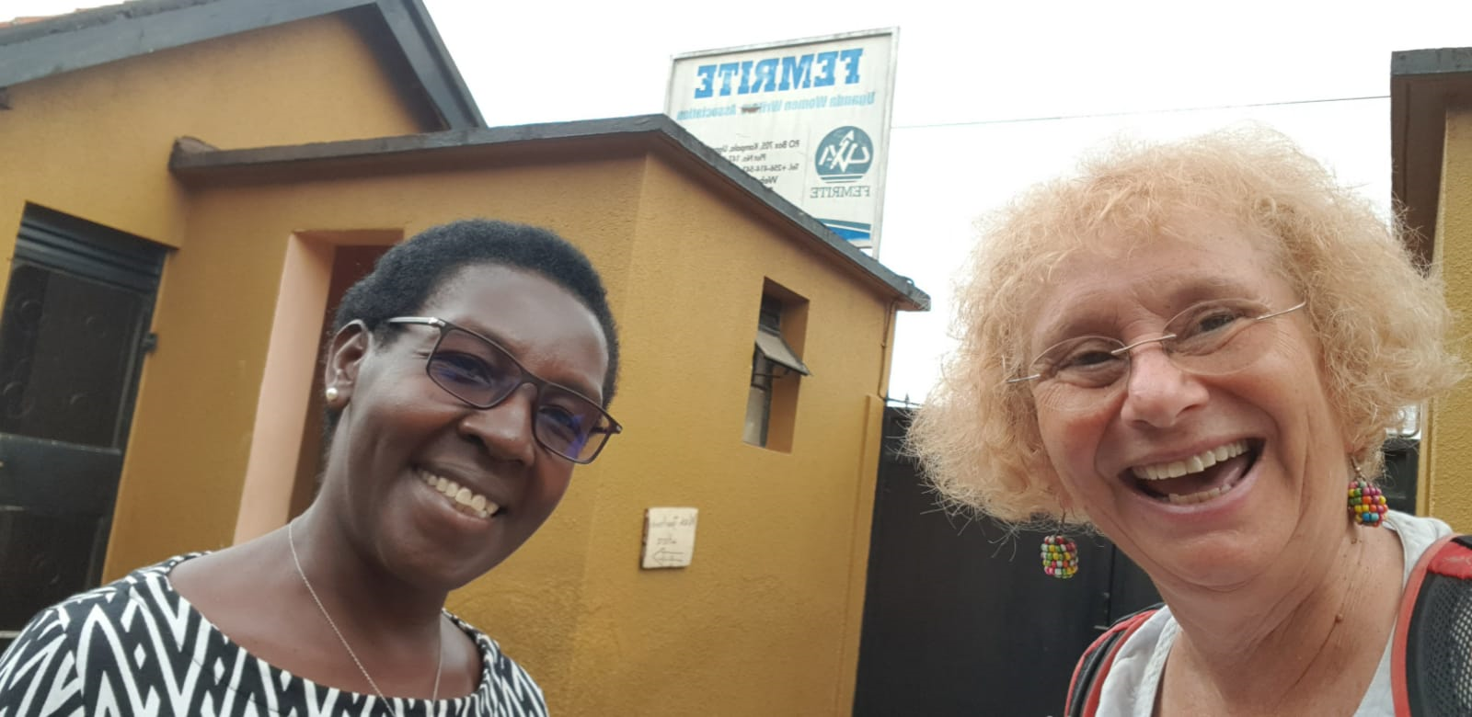

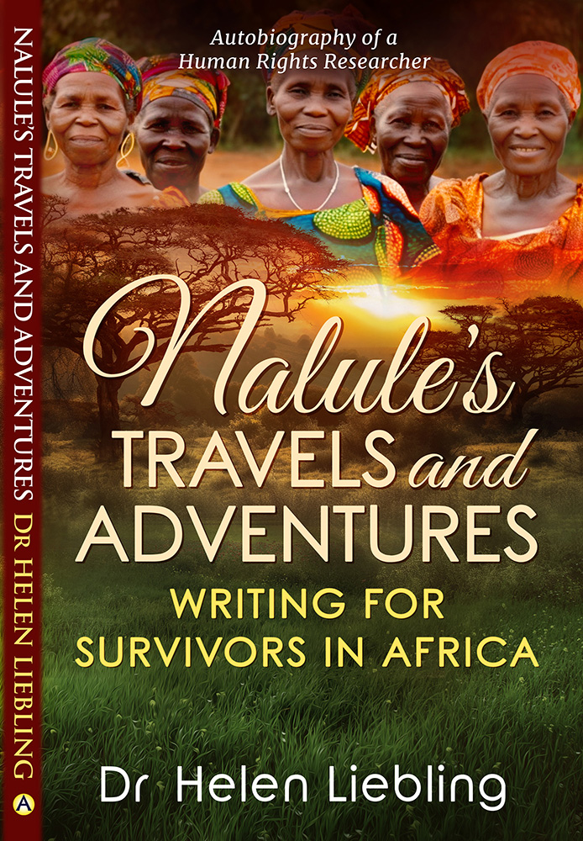
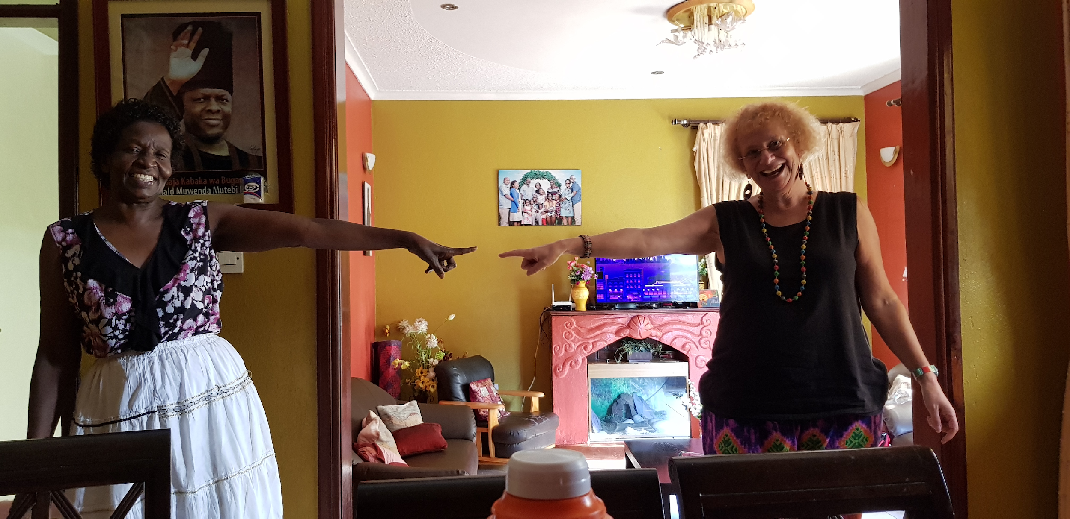
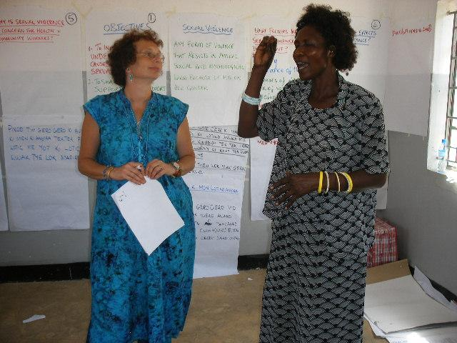
THANKS FOR LISTENING!
ANY QUESTIONS?
Hilda and Helen at Femrite
Gladys and I training on supporting survivors of SGBV in Orom, N. Uganda
Ruth and Helen in Kampala
Book can be bought on Amazon, Barnes & Noble, Blackwell’s, Booktopia, Fishpond, Waterstones and more!
Contact details:
Helen.Liebling@coventry.ac.uk
Notes:
Thanks very much for listening
Autobiography published by Aurora House in Australia
Grateful for their interest, enthusiasm and support through the process
Thanks Ink plotters writing group for feedback particularly Chris for reading all my chapters
Thanks to all my colleagues and survivors in Africa without which none of the progress we made during our work would have been possible; I remain honoured and humbled to work with you all
Welcome to purchase the book now or on Amazon (US/UK/AU) Barnes & Noble Blackwell’s UK Booktopia Fishpond Waterstones UK ...and more!
Happy to be contacted on e-mail-please do take a leaflet
Are there any questions?

